Slide 1

TOP Hit Prediction
Applied Data Science

Slide 2
SCOPE Identify Possible top hits based on song features
Background: Traditionally the music industry has relied on gut feelings and intuition to identify potential hits, but now data science techniques can be used to analyze song features and predict which songs are most likely to become popular/top hit.
Objectives: By analyzing the song features such as tempo, danceability, energy, and others, we aim to understand the characteristics that make a song popular. This information can be useful for music streaming platforms, record labels, and artists to make informed decisions about their music releases and marketing strategies.
Model evaluation: We will compare different models regarding accuracy, precision, recall.

Slide 3
SCOPE Identify Possible top hits based on song features
Data sources: we used four Spotify datasets provided by Kaggle. The datasets are:
3 data sets of the “Spotify Dataset 1921-2020, 600k+ Tracks”
artists.csv → Artist features like Popularity, Followers etc.
dict_artists.json → The artists recommended for fans of artists.
tracks.csv → The audio features of tracks.
1 data set of “Spotify tracks chart dataset (2014-2022)”
charts.csv → This dataset is comprised of weekly Spotify track chart data from 2014 to 2022. Used to get the chart position of the song in various countries.

Slide 4
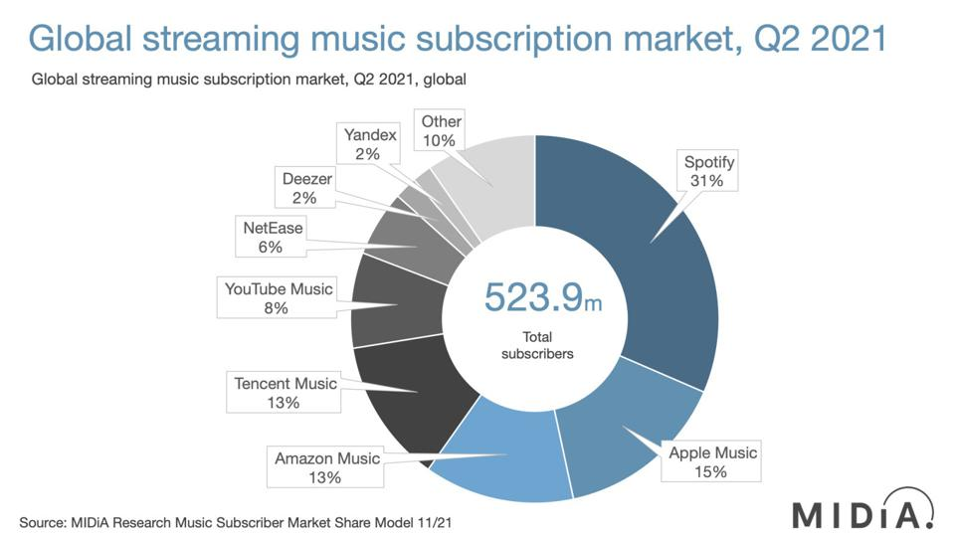
Notes:
Source: Forbes
https://www.forbes.com/sites/eamonnforde/2022/01/19/spotify-comfortably-remains-the-biggest-streaming-service-despite-its-market-share-being-eaten-into/?sh=6f71a5134743

Slide 5
Scope – Spotify API FEATURES
NAME | Description
Popularity | Measurement: Derived from absolute & recent number of streams
Energy | Liveliness of the song
Loudness | Derived from decibel measurements of the song
Liveness | Degree to which the song sounds like it was record live vs. studio produced
Danceability | Measurement of how easy it is to dance to the song
Speechiness | Measurement of words spoken
Instrumentalness | Measurement of instrumental sounds within the song
Valence | Measurement of the positivity of the song
Mode | Indication of modality (major or minor)
Excplicit | Indication whether the song contains swear words (yes or no)
Key | Standard pitch class notation (C to H)

Slide 6

Domain Exploration – Hit Song Science
Area first defined by Mike McCready in 2002 (CEO of Polyphonic)
Goal/Business Model:
Evaluate Hits before they are released
Identify & match musical preferences of certain groups
Original Procedure: Analyze mathematical structure of rhythm, changes in key & melodic pattern
Notes:
Brief literature review about domain and previous data science projects in this domain
Sources:
Ruth Dhanaraj; Beth Logan (2005) „AUTOMATIC PREDICTION OF HIT SONGS”
Internet → Web Archive 2005:
https://hitsongscience.com/
http://www.polyphonichmi.com/about_us.php

Slide 7
Domain Exploration – Previous Data Science Projects
Goals | Input | Features | Methods | Result
Predict Song Popularity (>90%) | Spotify Developer Application Programming Interface | Explicitness, Instrumentals, Danceability | KNN, Random Forest, Gradient Boosted Trees, Logistic Regr. | Max. 72% Accuracy
Predict Hit in Billboard Hot 100 | Million Song Data Set (MSD), Spotify API (Extra) | All API Features & Artist Score (Custom) & Release Time | EM, LR, GDA, SVM, DT and NN (RF) | 69 - 77% Accuracy (81 – 89% Accuracy)
Determine Variation of Attributes to Streams | Spotify API (Custom Python Code) | Genre (SF) & All API Features | Correlation Analysis, Linear Regression | Low Explanatory Power
Determine Variation of Attributes to Popularity | Spotify WEB API (Custom Code) ONE Artist | All API Features | Beta regression model, GLMM, Beta GLMM | Mixed Explanatory Power (some Pos, some neg, rest irrelev)
Determine Features of Successful Playlists | Spotify & Surveys |  | Plotting | Intimacy, Focus & Variety
Characterize Trendy Music Clusters | Spotify API | All API Features | KNN | Variety of Size & Attributes
Notes:
Sources:
L1: Dawson, Christopher E. Jr.; Mann, Steve; Roske, Edward; and Vasseur, Gauthier (2021) "Spotify: You have a Hit!," SMU Data Science Review: Vol. 5: No. 3, Article 9.
L2: Georgieva, Elena; Suta Marcella; Burton, Nicholas: “HITPREDICT: PREDICTING HIT SONGS USING SPOTIFY DATA” (2018)
L2,5: Middlebrook, Kai; Sheik, Kian: „SONG HIT PREDICTION: PREDICTING BILLBOARD HITS USING SPOTIFY DATA “ (2019)
L3: Nijkamp, Rutger “Prediction of product success: explaining song popularity by audio features from Spotify data” (2018)
L4: Spera, Carola; Sciandra, Marangela “A Model Based Approach to Spotify Data Analysis: A Beta GLMM” (2020)
L5: George John Jordan Thomas Aquinas Hayward „What makes a playlist succesful? “ (https://ghayward.github.io/assets/files/Data_Scientist_Presentation_George_JJTA_Hayward.pdf)
L6: http://www.na-businesspress.com/JMDC/JMDC14-3/8_Al-BeitawiFinal.pdf
Abkürzungen:
Expectation Maximization (EM), Logistic Regression (LR), Gaussian Discriminant Analysis (GDA), Support Vector Machines (SVM), Decision Trees (DT), and Neural Networks (NN)
Random Forest (RF)
Generalized Linear Mixed Models (GLMM)
All API Features:
Danceability, Energy, Speechiness, Acousticness, Instrumentalness, Liveness, Valence, Loudness, and Tempo
Duration, Mode

Slide 8

Domain Exploration – Results
Hit Song Science is a is a field in the Data Science area, which is of great economic & academic interest
Spotify API is the best public available feature data base, providing multiple seemingly independent characteristics
Limitations of investigation:
Bias due to usage of Spotify API as main source
Primarily consists of measurable Song Information; e.g. no genres
Spotify provides no in depth details of feature calculation
Most Researches Excludes Soft Factors
Possible enrichment of the data with corresponding data
Main metric of the projects was "Accuracy" - "Precision" & "Recall" were mostly considered only secondarily, if at all

Slide 9
Data Exploration
4 original datasets from kaggle: tracks - contains track features charts - contains chart position of tracks, track ids and artist ids artists - contains artists and their popularity recommended artists - contains artists recommendations for artists by ids
Notes:
Introduction to use case, goal, selection of data set

Slide 10
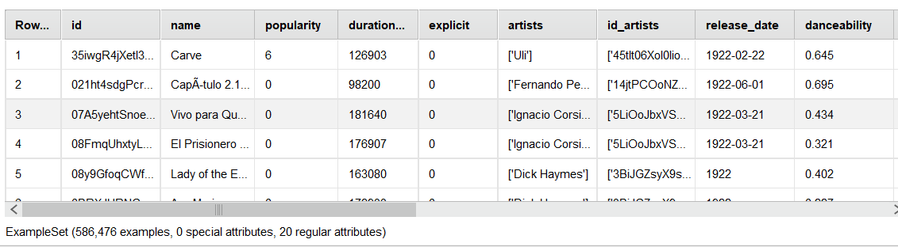
Tracks Data
Notes:
Introduction to use case, goal, selection of data set

Slide 11
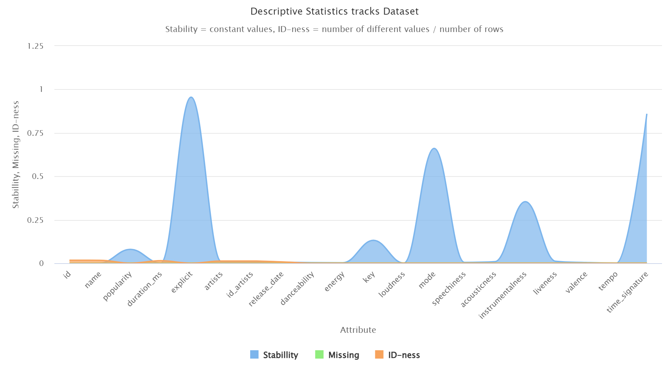
ARTISTS Data
Notes:
Introduction to use case, goal, selection of data set

Slide 12
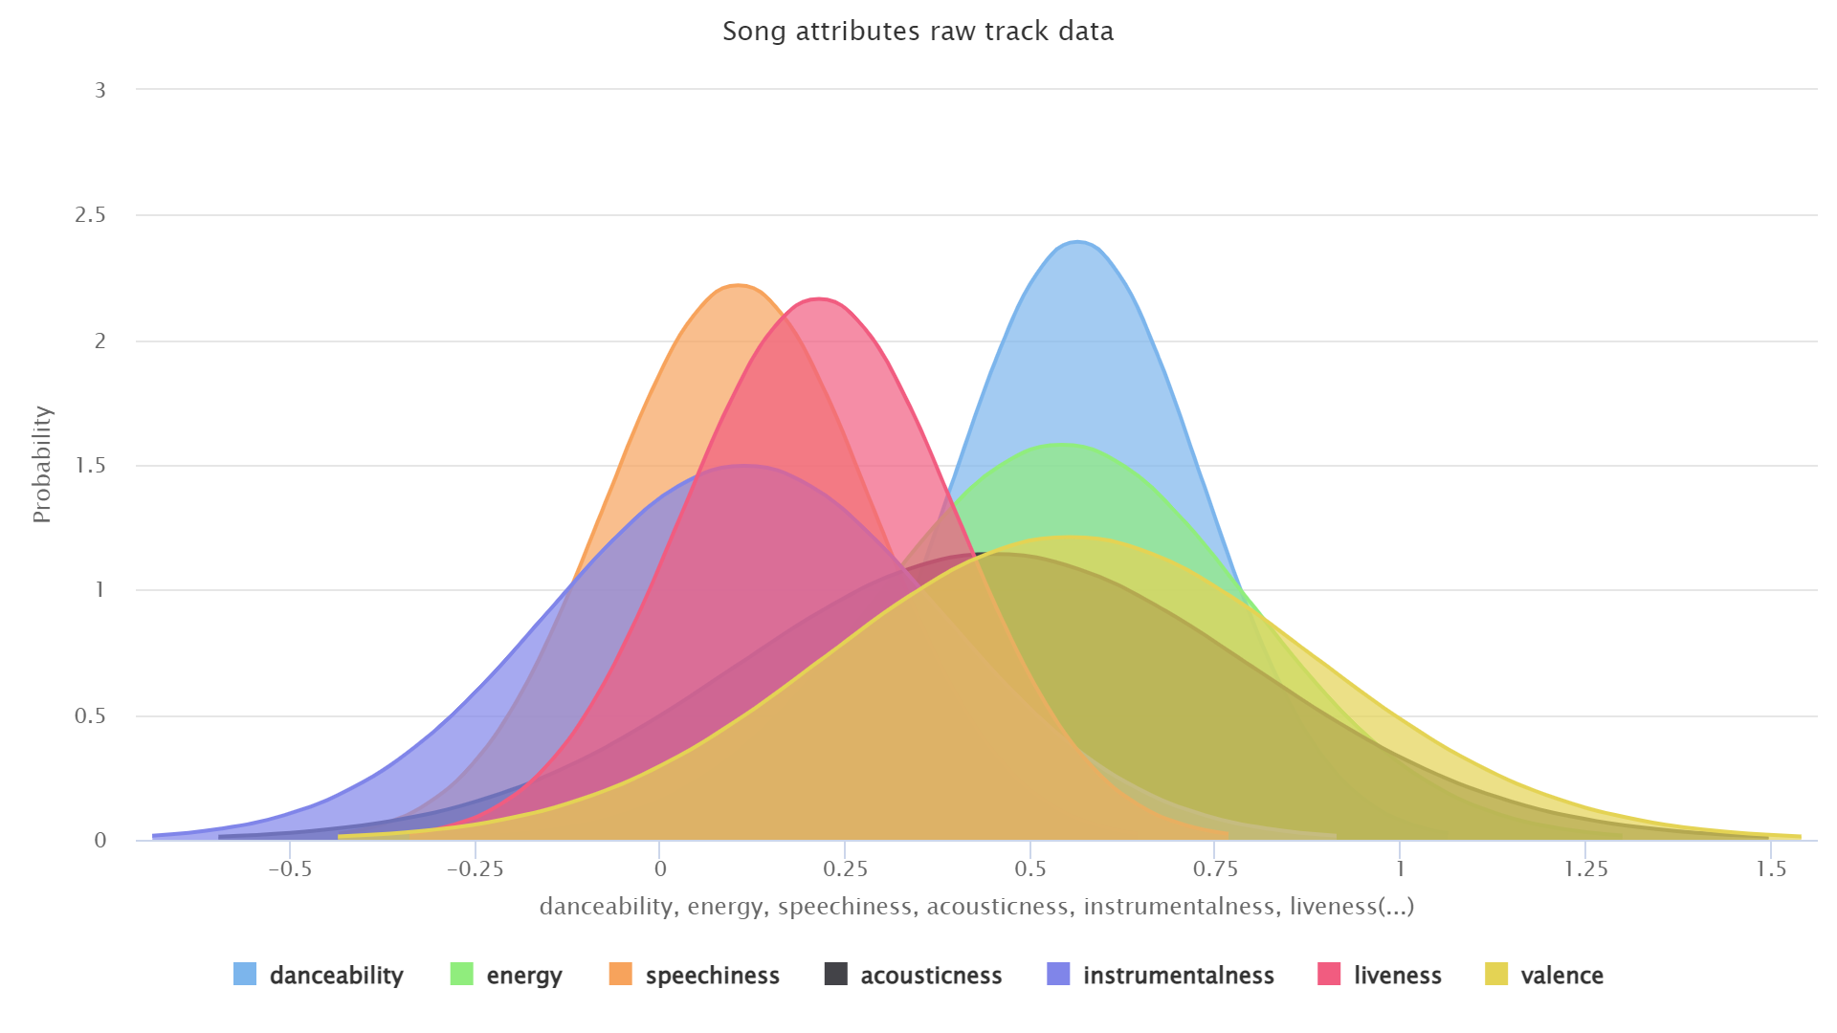
Tracks Data
Notes:
Introduction to use case, goal, selection of data set

Slide 13
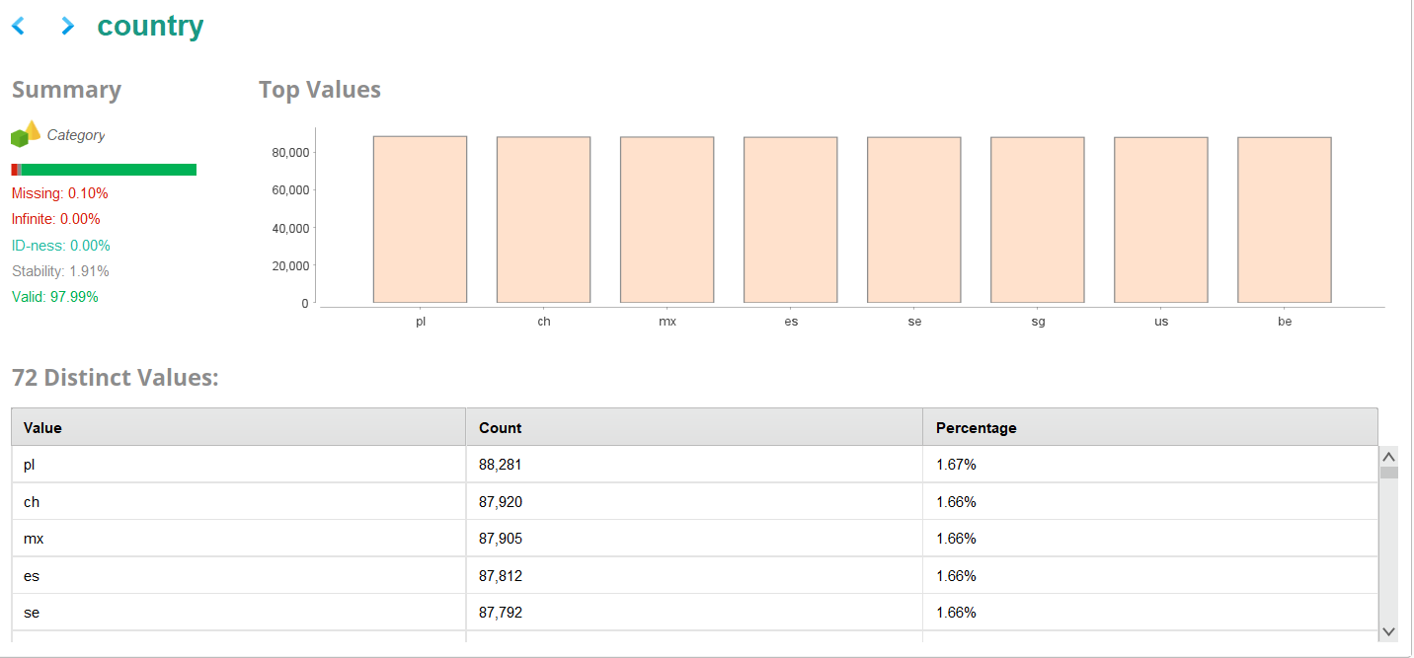
Tracks Data
Notes:
Introduction to use case, goal, selection of data set

Slide 14
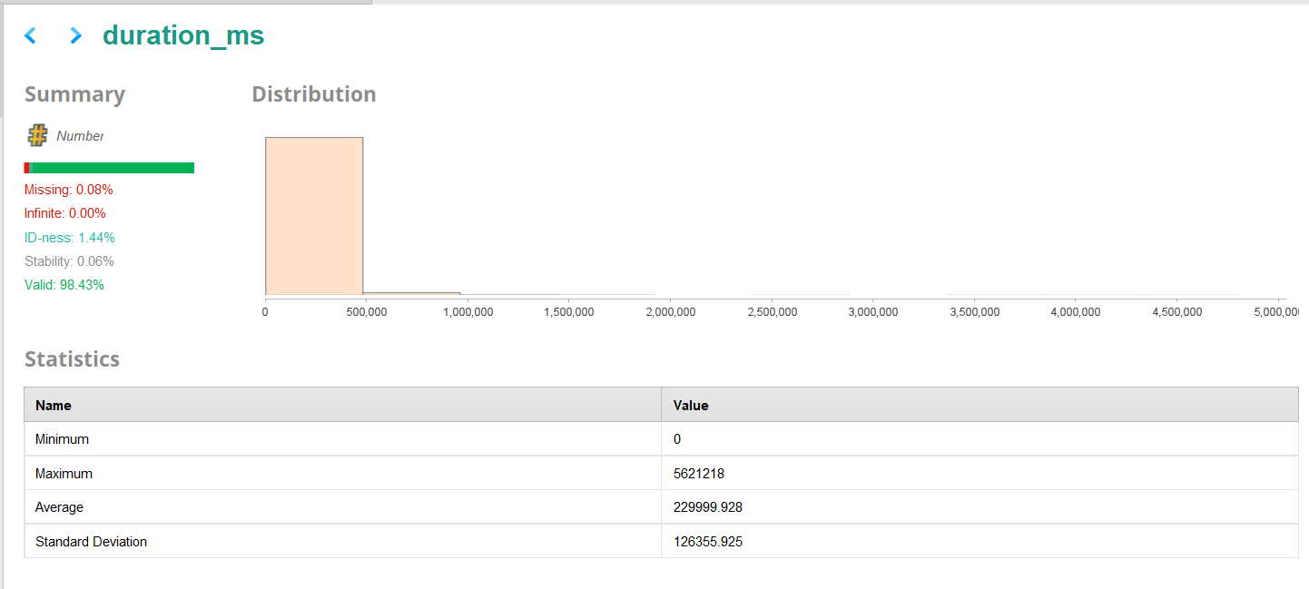
Tracks Data
Notes:
Introduction to use case, goal, selection of data set

Slide 15
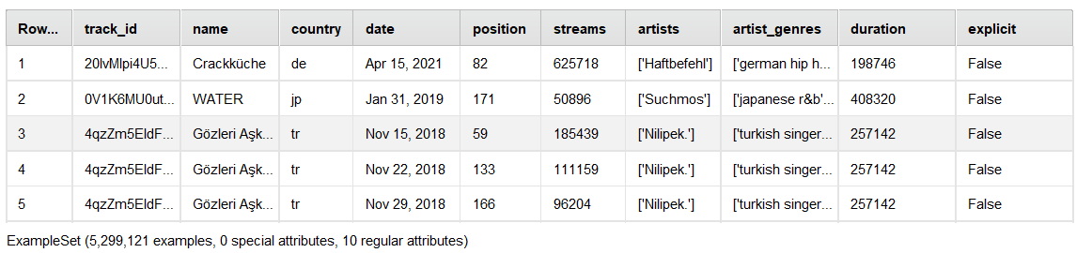
cHARTS Data
Notes:
Introduction to use case, goal, selection of data set

Slide 16
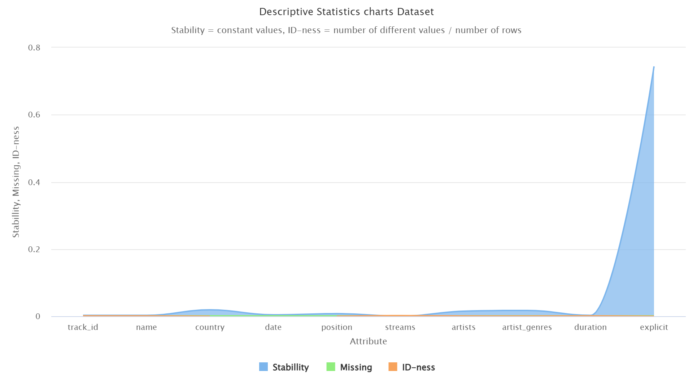
ARTISTS Data
Notes:
Introduction to use case, goal, selection of data set

Slide 17
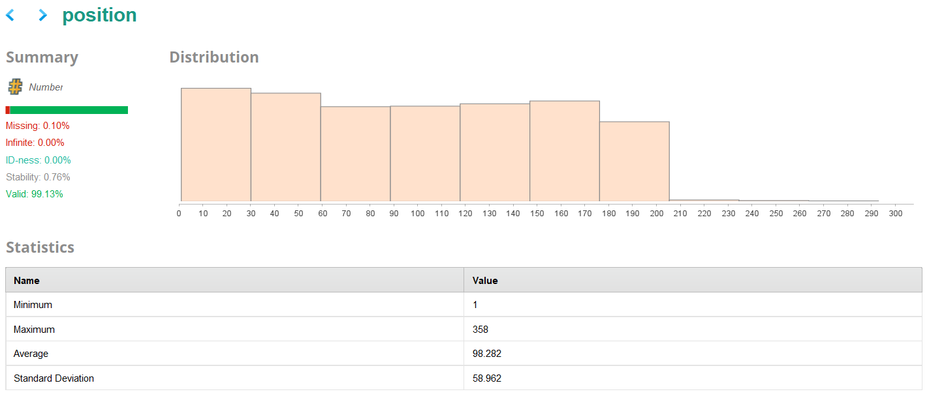
ARTISTS Data
Notes:
Introduction to use case, goal, selection of data set

Slide 18
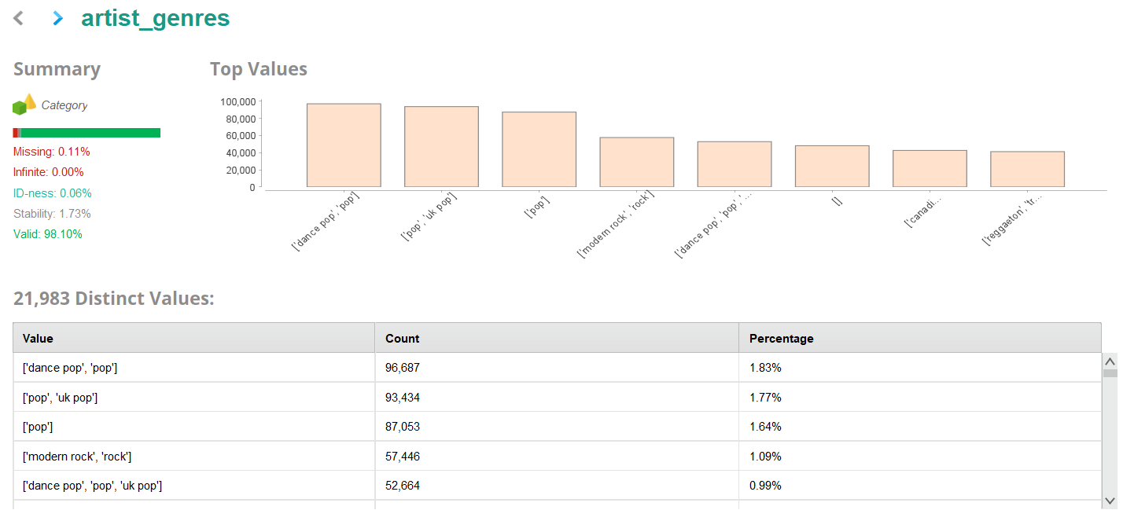
ARTISTS Data
Notes:
Introduction to use case, goal, selection of data set

Slide 19
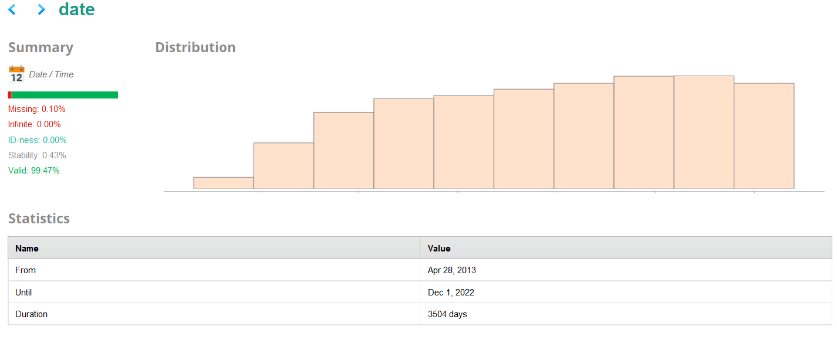
ARTISTS Data
Notes:
Introduction to use case, goal, selection of data set

Slide 20
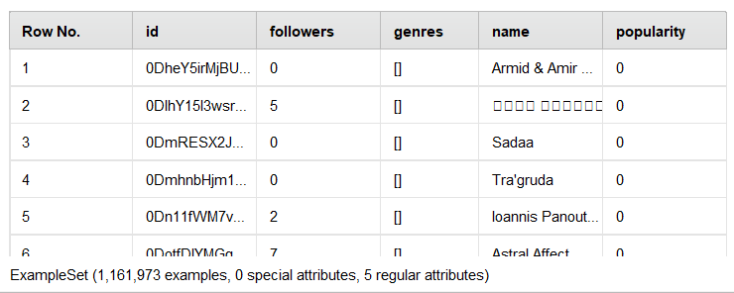
ARTISTS Data
Notes:
Introduction to use case, goal, selection of data set

Slide 21
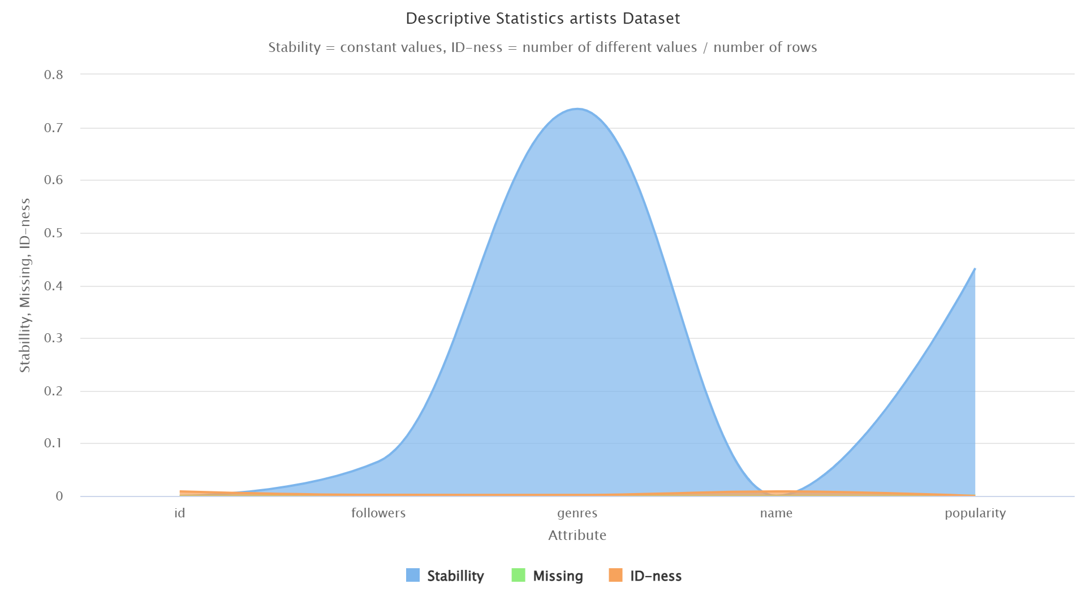
ARTISTS Data
Notes:
Introduction to use case, goal, selection of data set

Slide 22
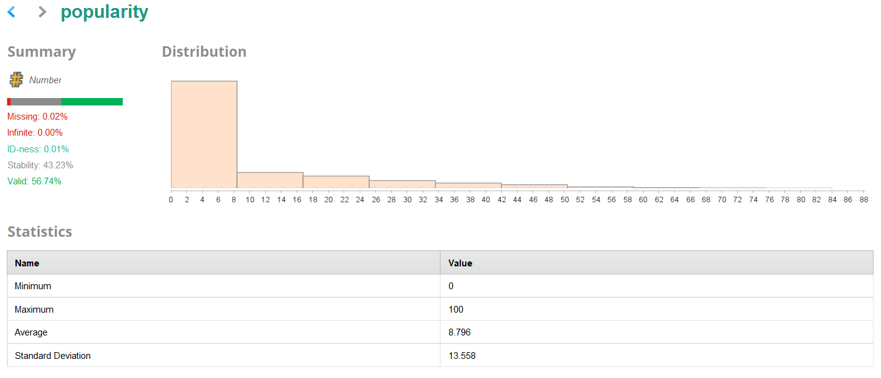
ARTISTS Data
Notes:
Introduction to use case, goal, selection of data set

Slide 23
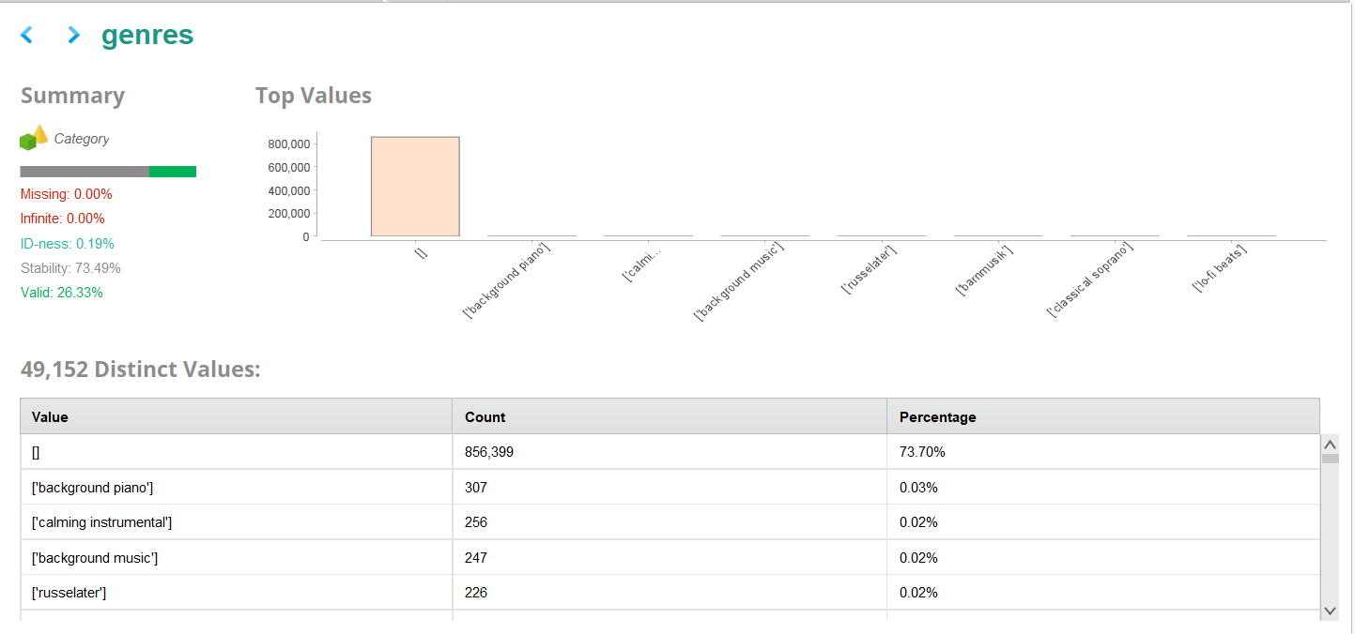
ARTISTS Data
Notes:
Introduction to use case, goal, selection of data set

Slide 24
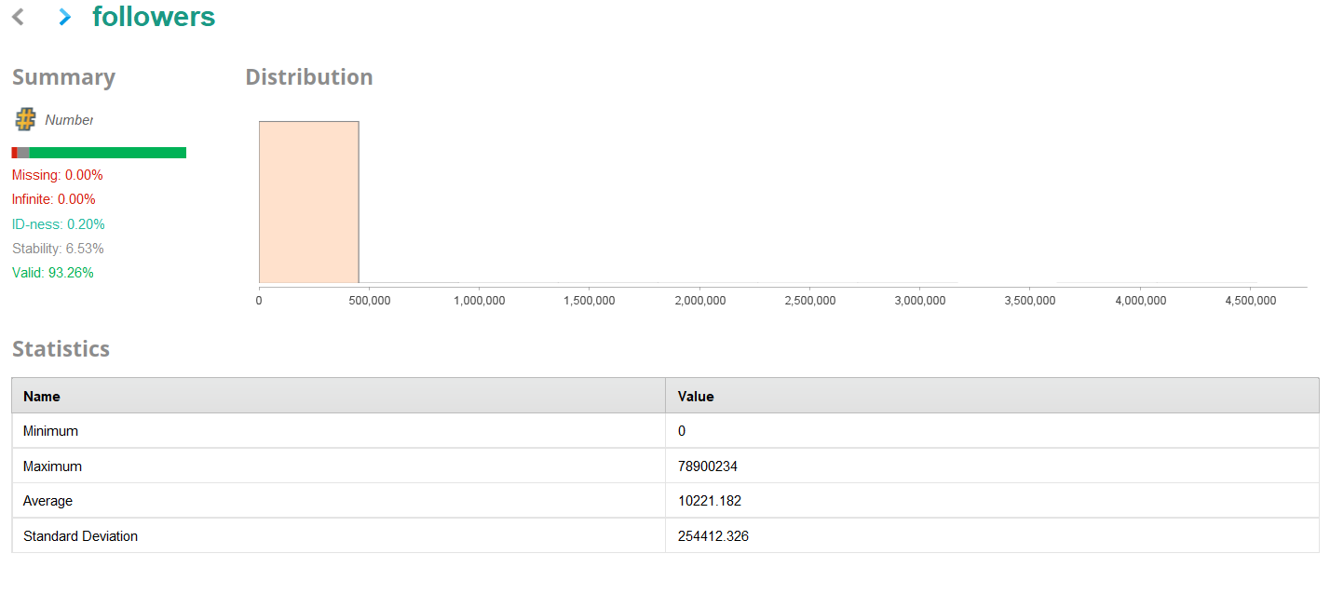
ARTISTS Data
Notes:
Introduction to use case, goal, selection of data set

Slide 25
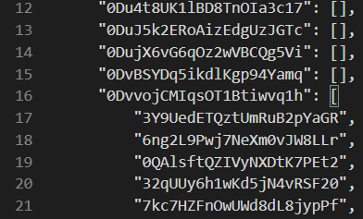
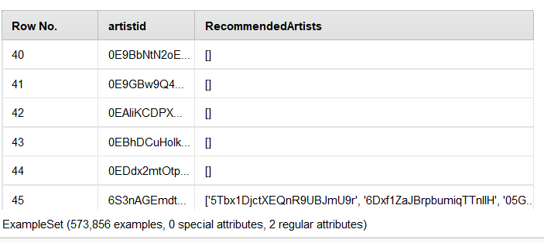
Recommended Artists Data
Notes:
Introduction to use case, goal, selection of data set

Slide 26
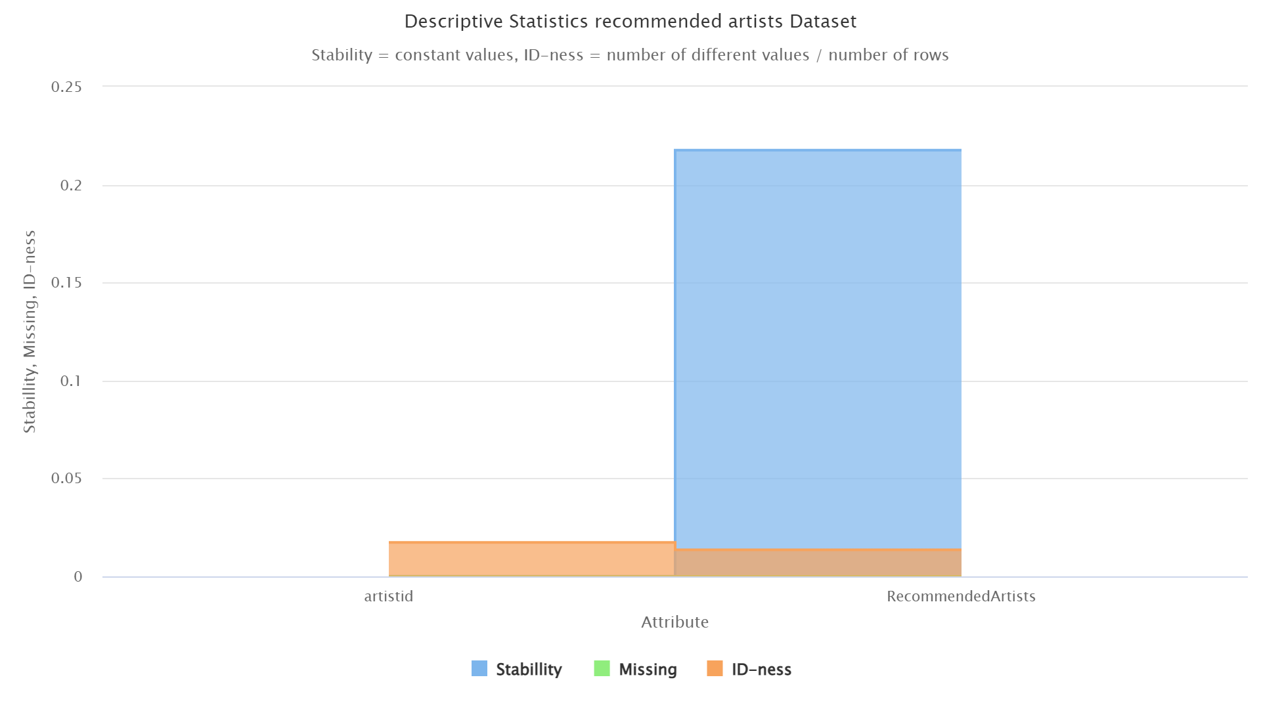
ARTISTS Data
Notes:
Introduction to use case, goal, selection of data set

Slide 27
Data Exploration Insights
Some data points are missing (genres in artist dataset) – fix through joining and data engineering
Either popularity or chartsposition could work for generating a top song label (feature engineering) Distributions are right skewed and should be normalized
Country and date information in datasets
Notes:
Introduction to use case, goal, selection of data set

Slide 28
Data Engineering
Iterative process to gain 2 main datasets: 1. “Fin Table” Dataset - track ids, popularity, charts position and specific musical features calculated by Spotify. Created by joining track and charts datasets from Kaggle in SQL (size issue with RapidMiner). 2. Cleanset Dataset – training data for modeling to see which features impact a “Top Song” in which way
“Top Song” label needs to be defined: 1. Top song by popularity – track popularity ≥85 (out of 100) = Top Song. 2. Top song by charts position – lowest charts position of a track ≤30 = Top Song. (We disregard different countries for our evaluation and take the lowest / highest measure for all countries)
Notes:
Introduction to use case, goal, selection of data set

Slide 29
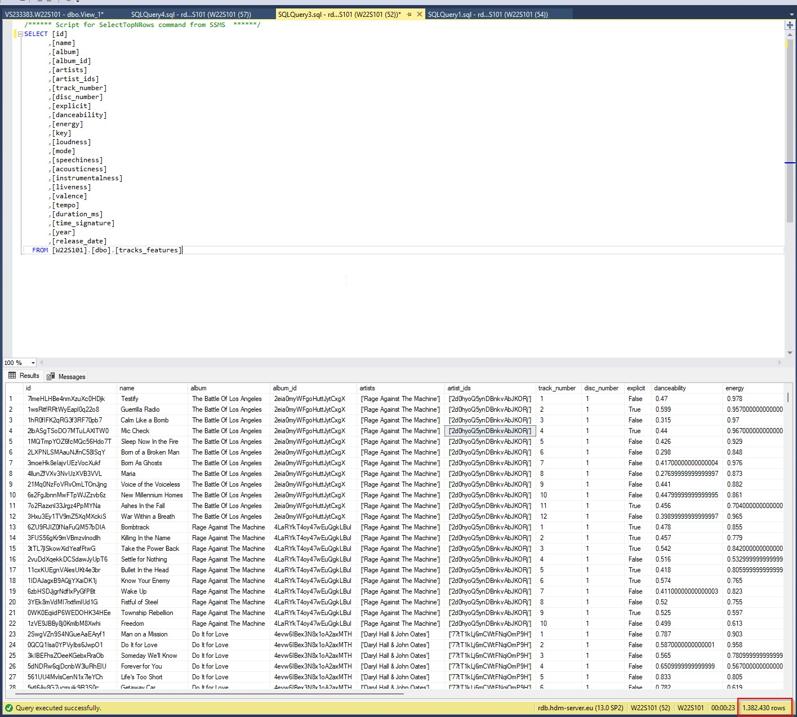
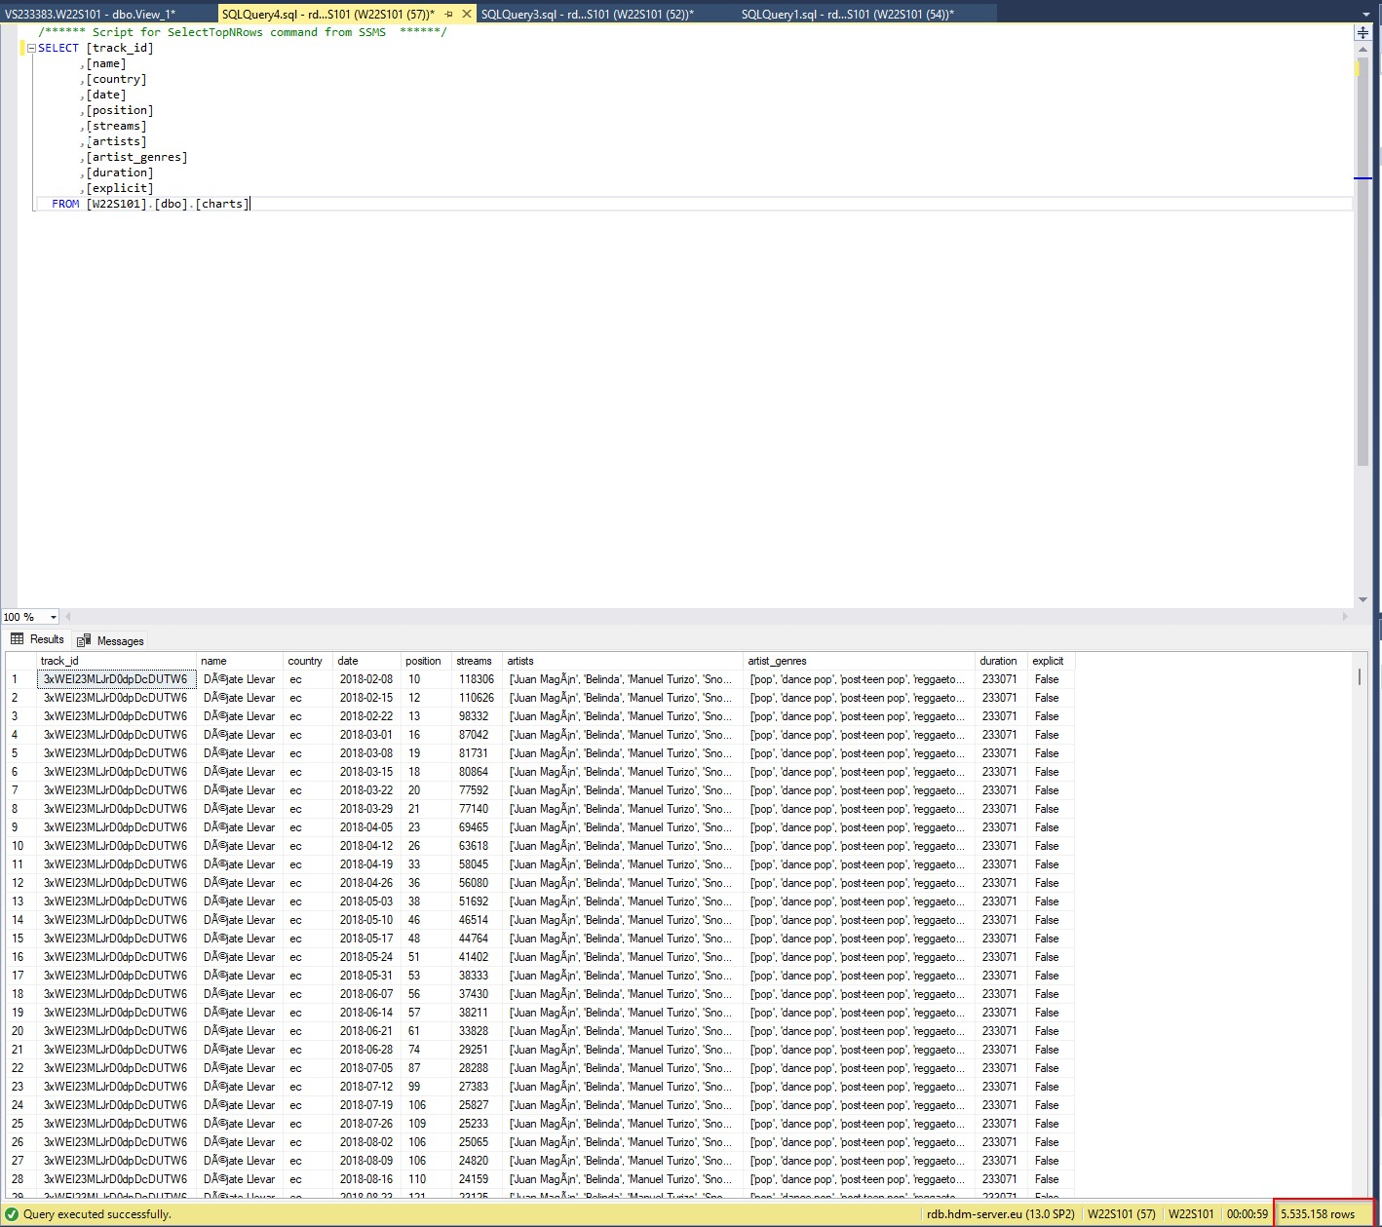
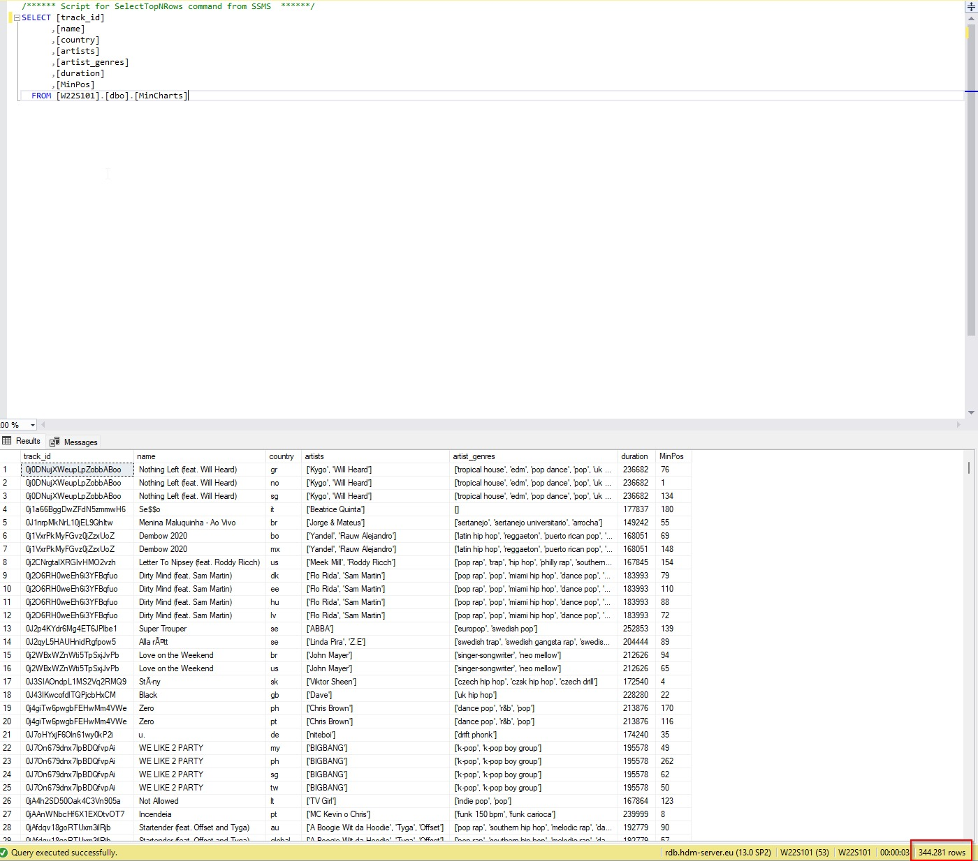
Create Fin Table
Load Data in SQL
Aggregate min(ChartsPos)
reduce 5 mio. to 344281 Rows
Join Charts with Track dataset to generate Fin Table
Notes:
Introduction to use case, goal, selection of data set

Slide 30
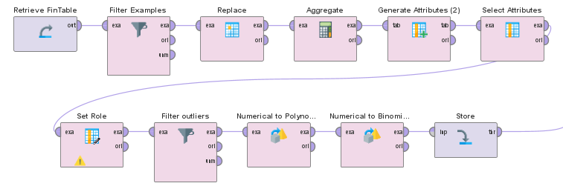
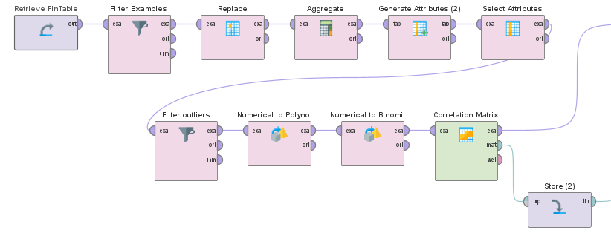
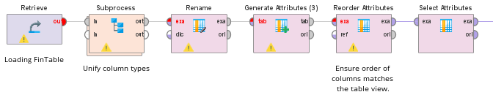
Data Wrangling and additional exploration Fin Table
Iterative process
Inspected Dataset for missing and wrong values to replace
Filtered outliers
Created Top Song label by popularity and by min(chartsPos) to compare
Notes:
Source: Forbes
https://www.forbes.com/sites/eamonnforde/2022/01/19/spotify-comfortably-remains-the-biggest-streaming-service-despite-its-market-share-being-eaten-into/?sh=6f71a5134743

Slide 31
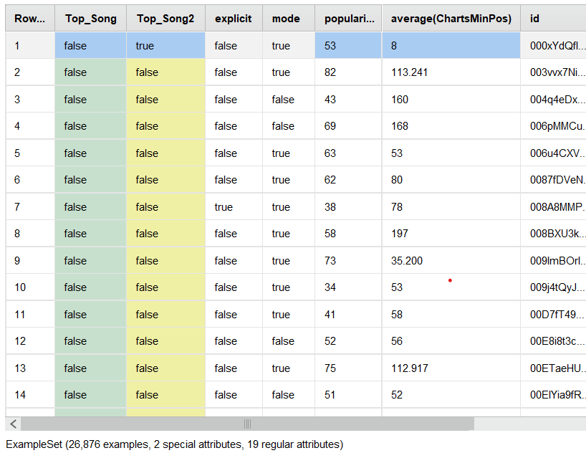
Fin Table
Notes:
Source: Forbes
https://www.forbes.com/sites/eamonnforde/2022/01/19/spotify-comfortably-remains-the-biggest-streaming-service-despite-its-market-share-being-eaten-into/?sh=6f71a5134743

Slide 32
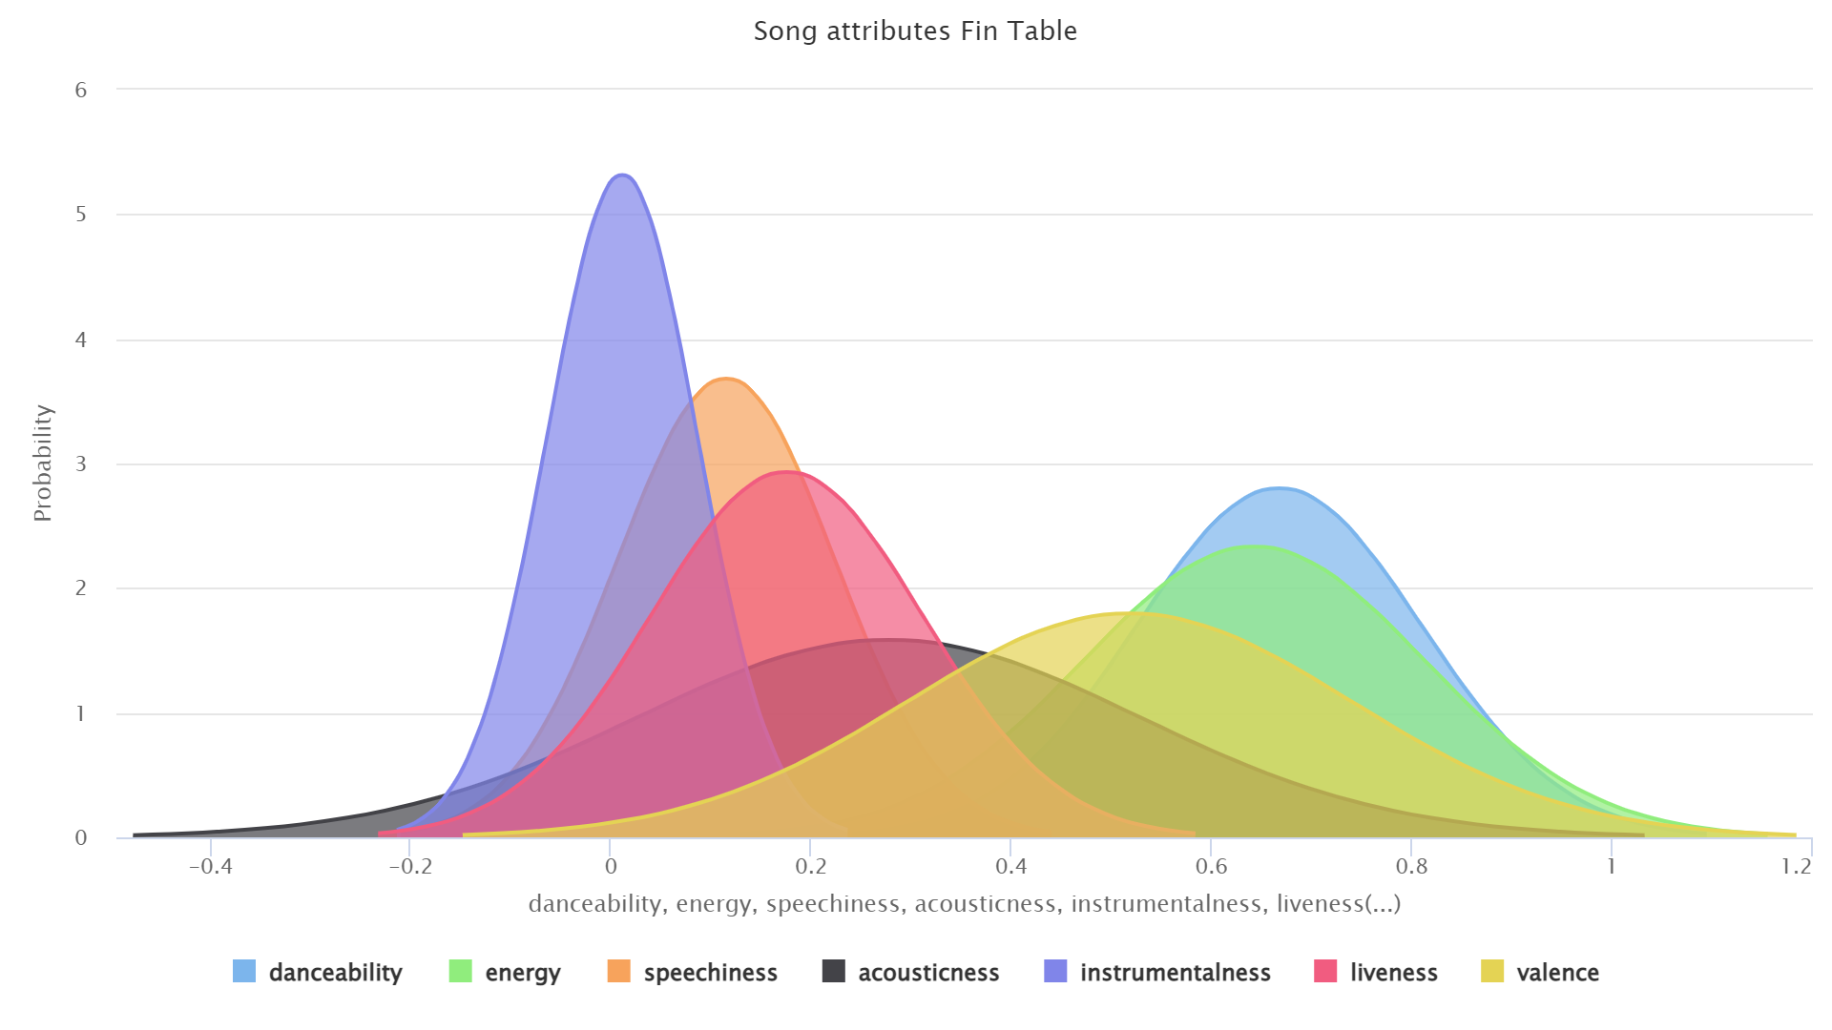
Notes:
Source: Forbes
https://www.forbes.com/sites/eamonnforde/2022/01/19/spotify-comfortably-remains-the-biggest-streaming-service-despite-its-market-share-being-eaten-into/?sh=6f71a5134743

Slide 33
Tracks Data
Notes:
Introduction to use case, goal, selection of data set

Slide 34
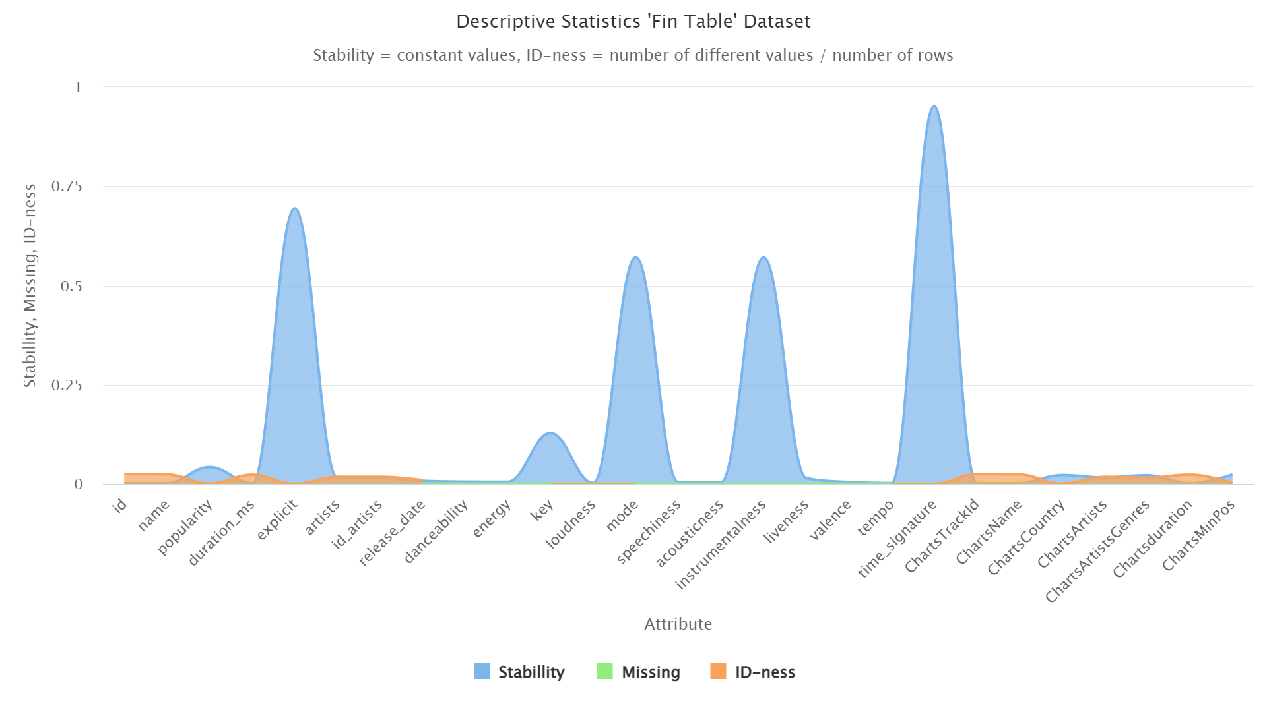
Notes:
Source: Forbes
https://www.forbes.com/sites/eamonnforde/2022/01/19/spotify-comfortably-remains-the-biggest-streaming-service-despite-its-market-share-being-eaten-into/?sh=6f71a5134743

Slide 35
ARTISTS Data
Notes:
Introduction to use case, goal, selection of data set

Slide 36
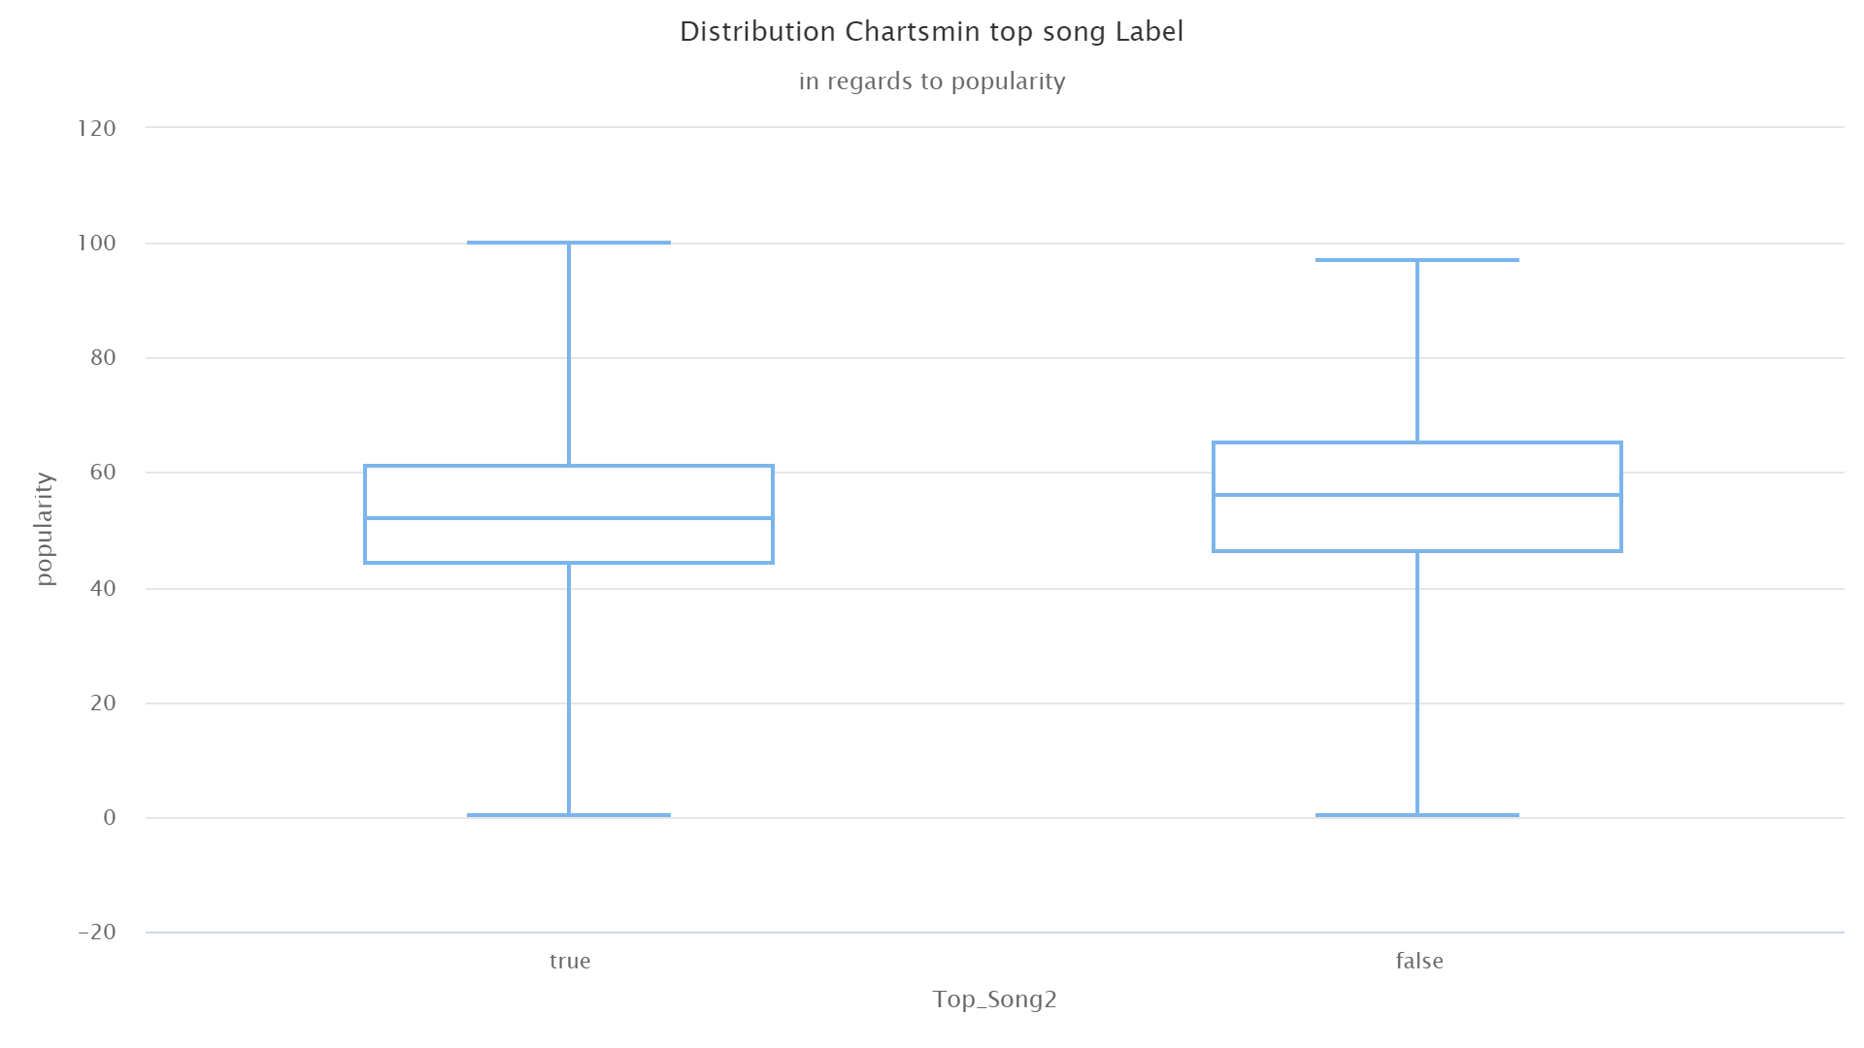
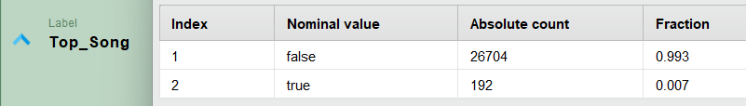
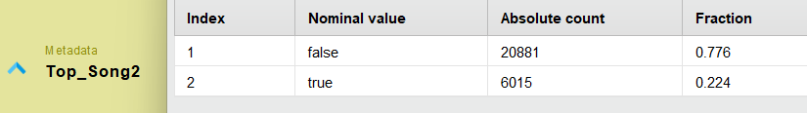
Comparison Top Song Label by Popularity and MINimum Charts Position
Notes:
Introduction to use case, goal, selection of data set

Slide 37
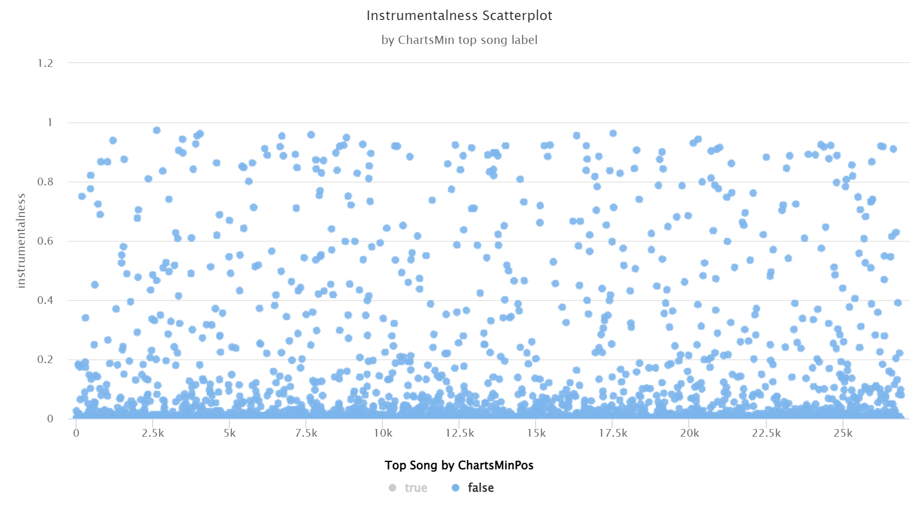
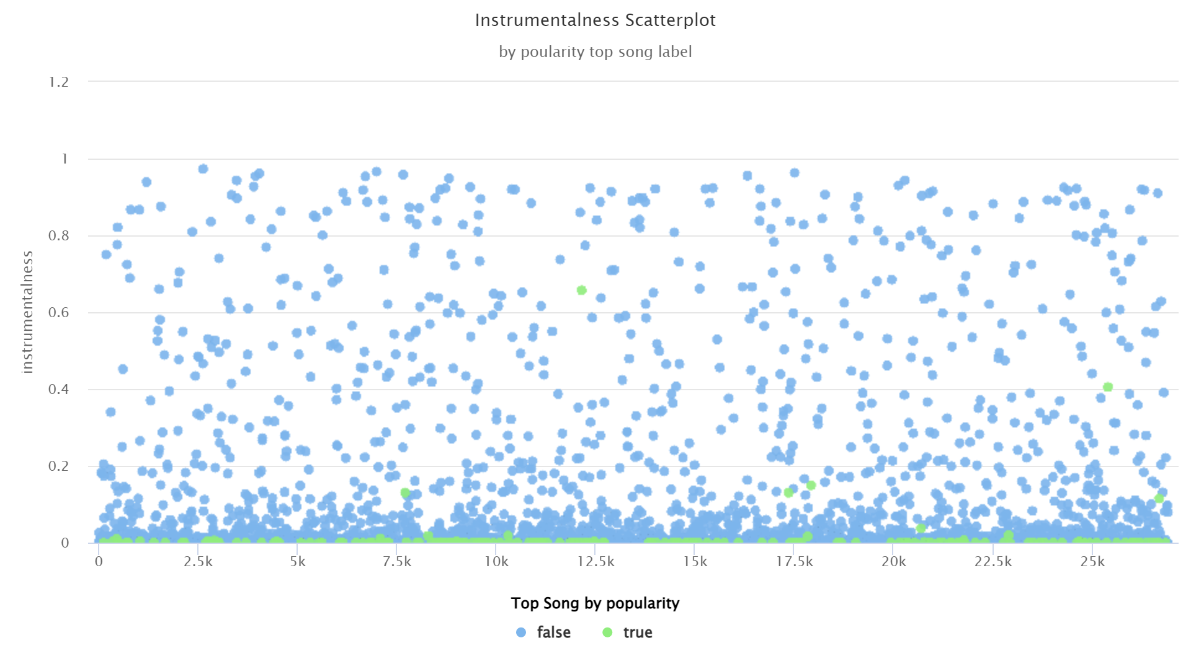
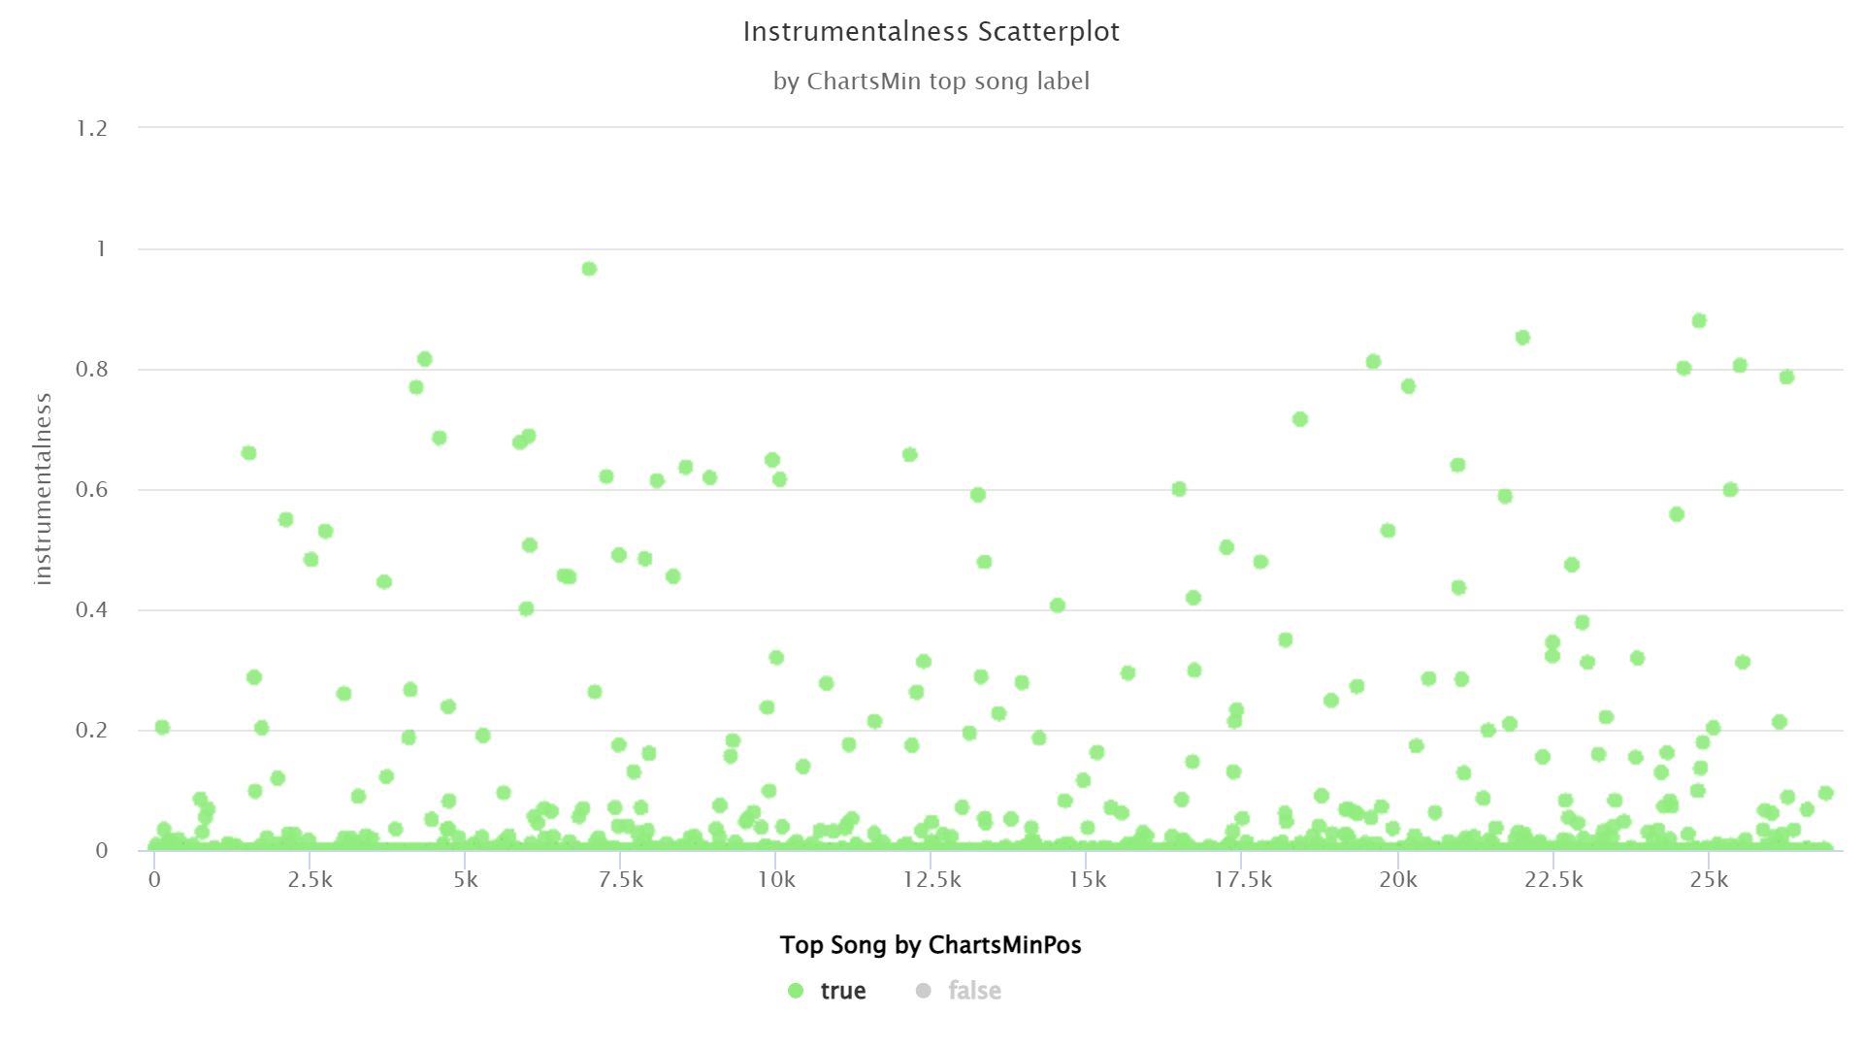
Notes:
Source: Forbes
https://www.forbes.com/sites/eamonnforde/2022/01/19/spotify-comfortably-remains-the-biggest-streaming-service-despite-its-market-share-being-eaten-into/?sh=6f71a5134743

Slide 38
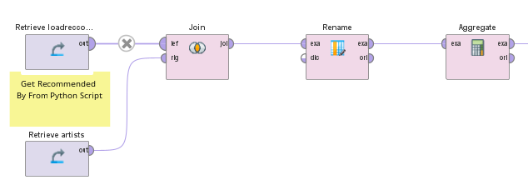
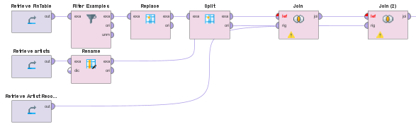
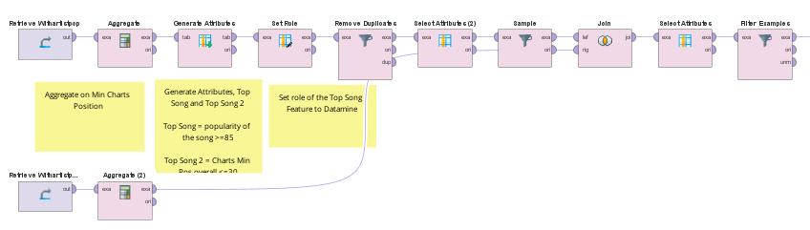
Final Engineering to Create Training Data “Cleanset”
1. Join artists and recommended artists
2. Join Fin Table, previous join and artists data
3. Create Cleanset with Top Song label by min(chartsPos). Balanced label by downsampling to 6000 each
Notes:
Source: Forbes
https://www.forbes.com/sites/eamonnforde/2022/01/19/spotify-comfortably-remains-the-biggest-streaming-service-despite-its-market-share-being-eaten-into/?sh=6f71a5134743

Slide 39
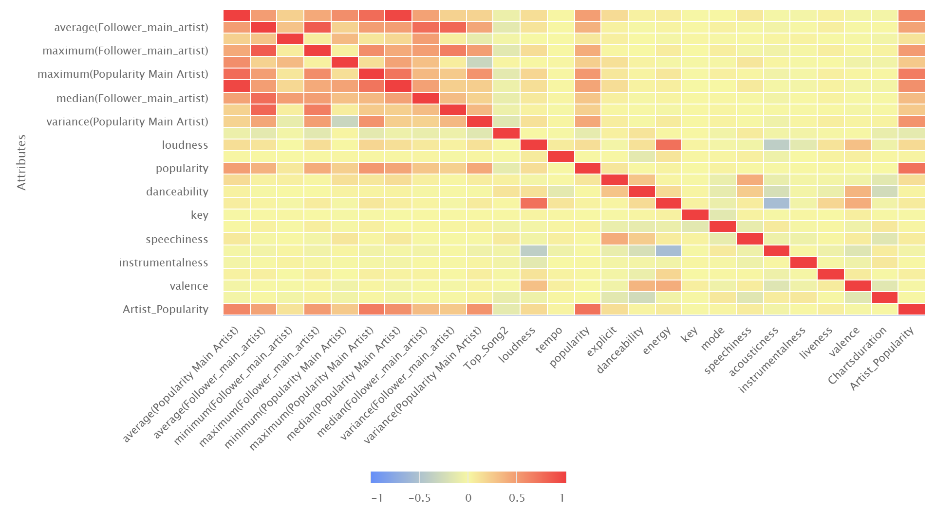
Notes:
Source: Forbes
https://www.forbes.com/sites/eamonnforde/2022/01/19/spotify-comfortably-remains-the-biggest-streaming-service-despite-its-market-share-being-eaten-into/?sh=6f71a5134743

Slide 40
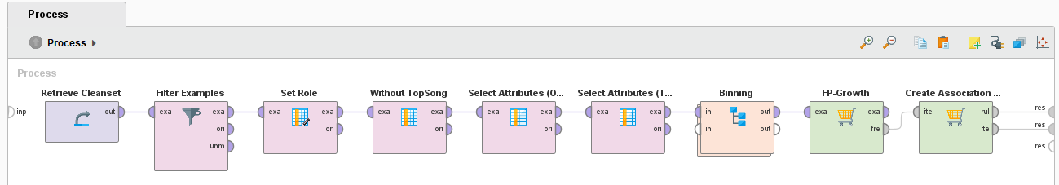
Modeling: FP Growth – Process General
Frequent Item Combinations
Result: „If Song has Feature X then it also has Feature Y“
Requirement: Need to convert features from quantitave to categorial
Bias: No direct comparision between „Top Song“ & „No Top Song“

Slide 41
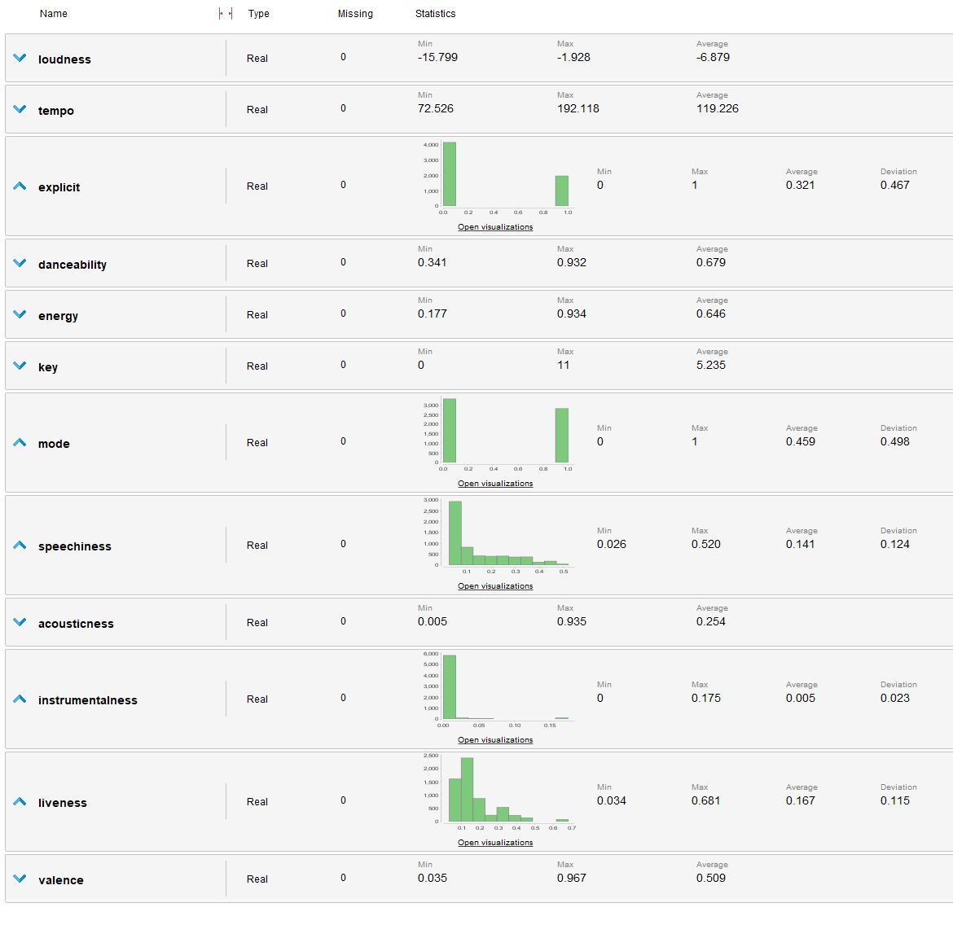
Modeling: FP Growth – Imbalanced Attributes

Slide 42
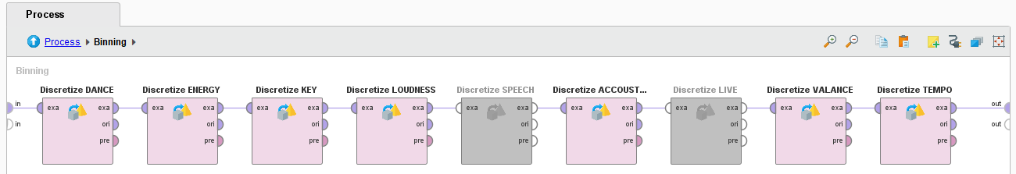
Modeling: FP Growth – Process Binning
Customized Binning
Advantage: Range adapted to the scale & classes directly readable
Disadvantage: High Manual Effort – To be adjusted with every change

Slide 43
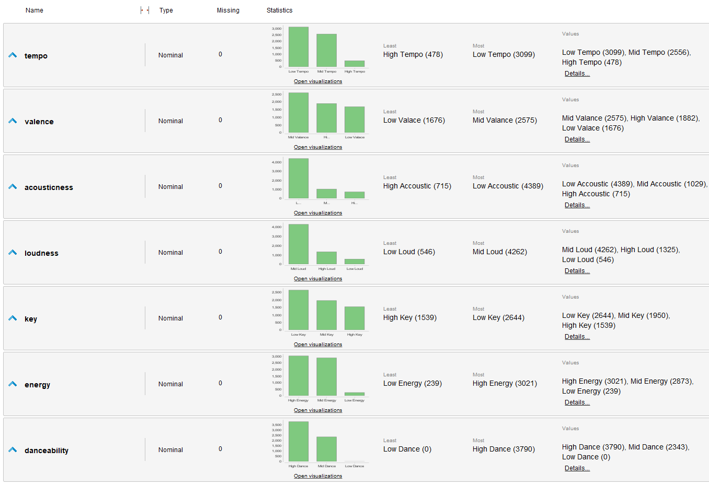
Modeling: FP Growth – Binning Result

Slide 44
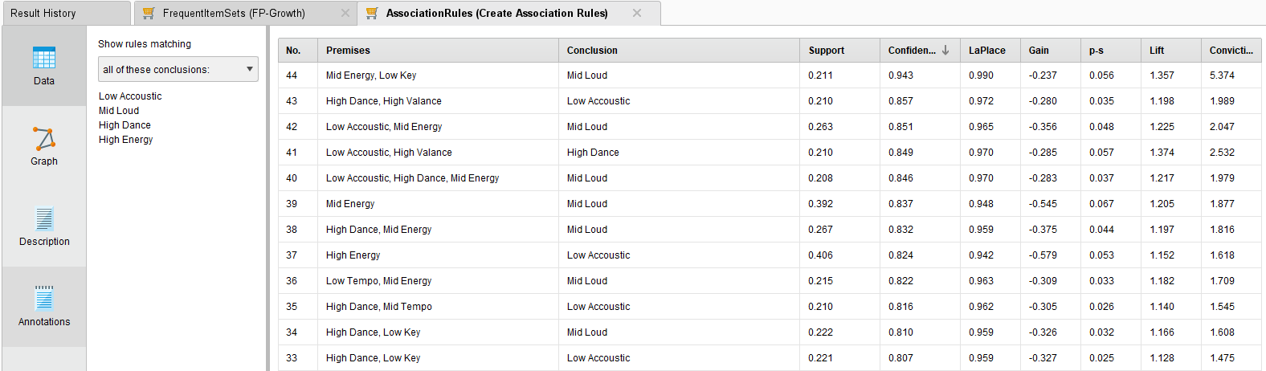
Modeling: FP Growth – Result “TRUE”

Slide 45
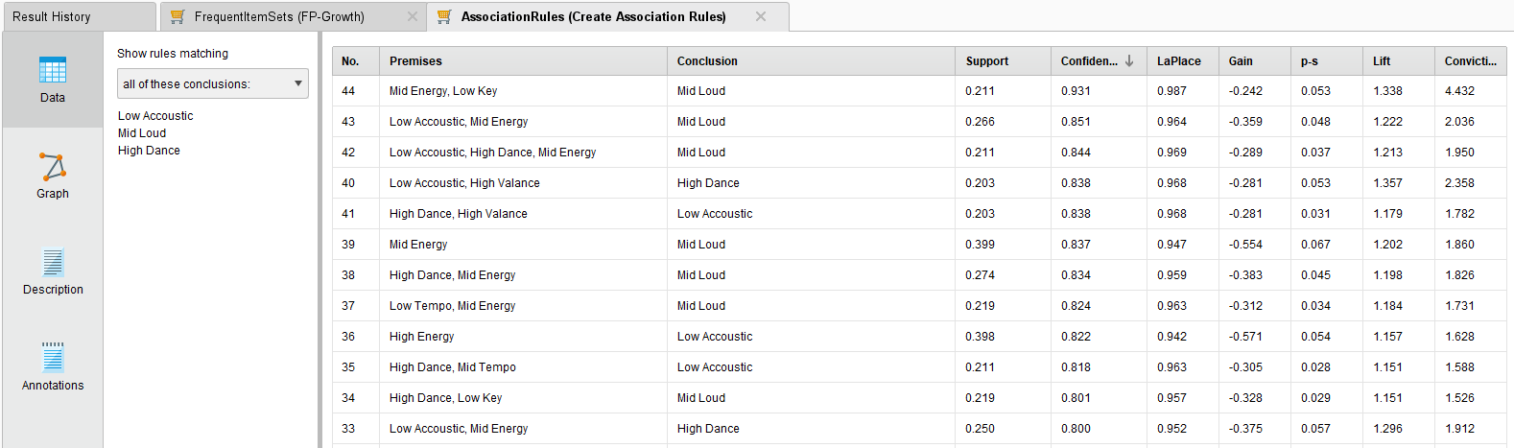
Modeling: FP Growth – Result “FALSE”

Slide 46
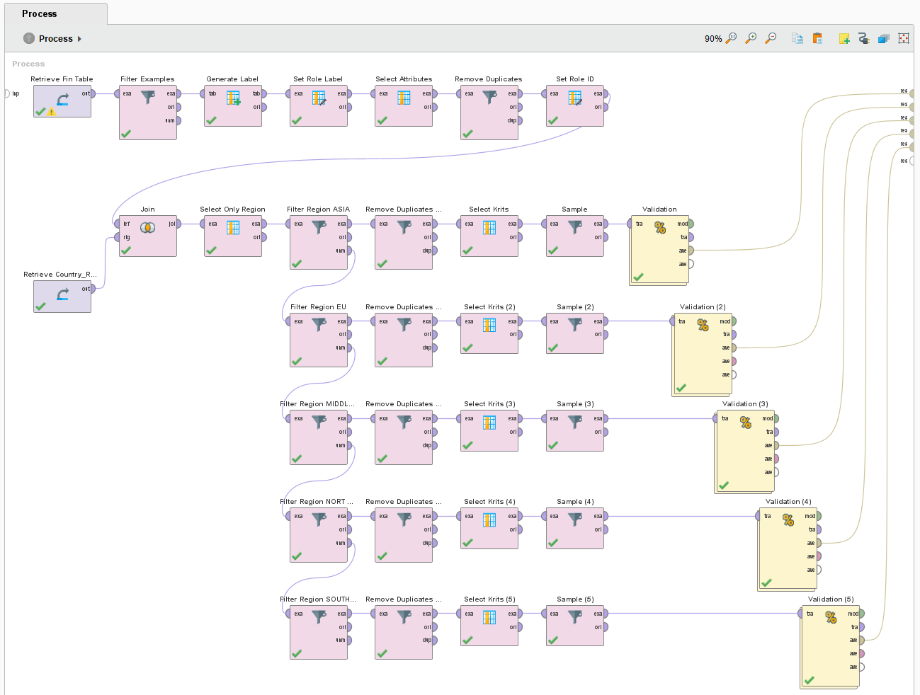
Modeling: REGION – Process General

Slide 47
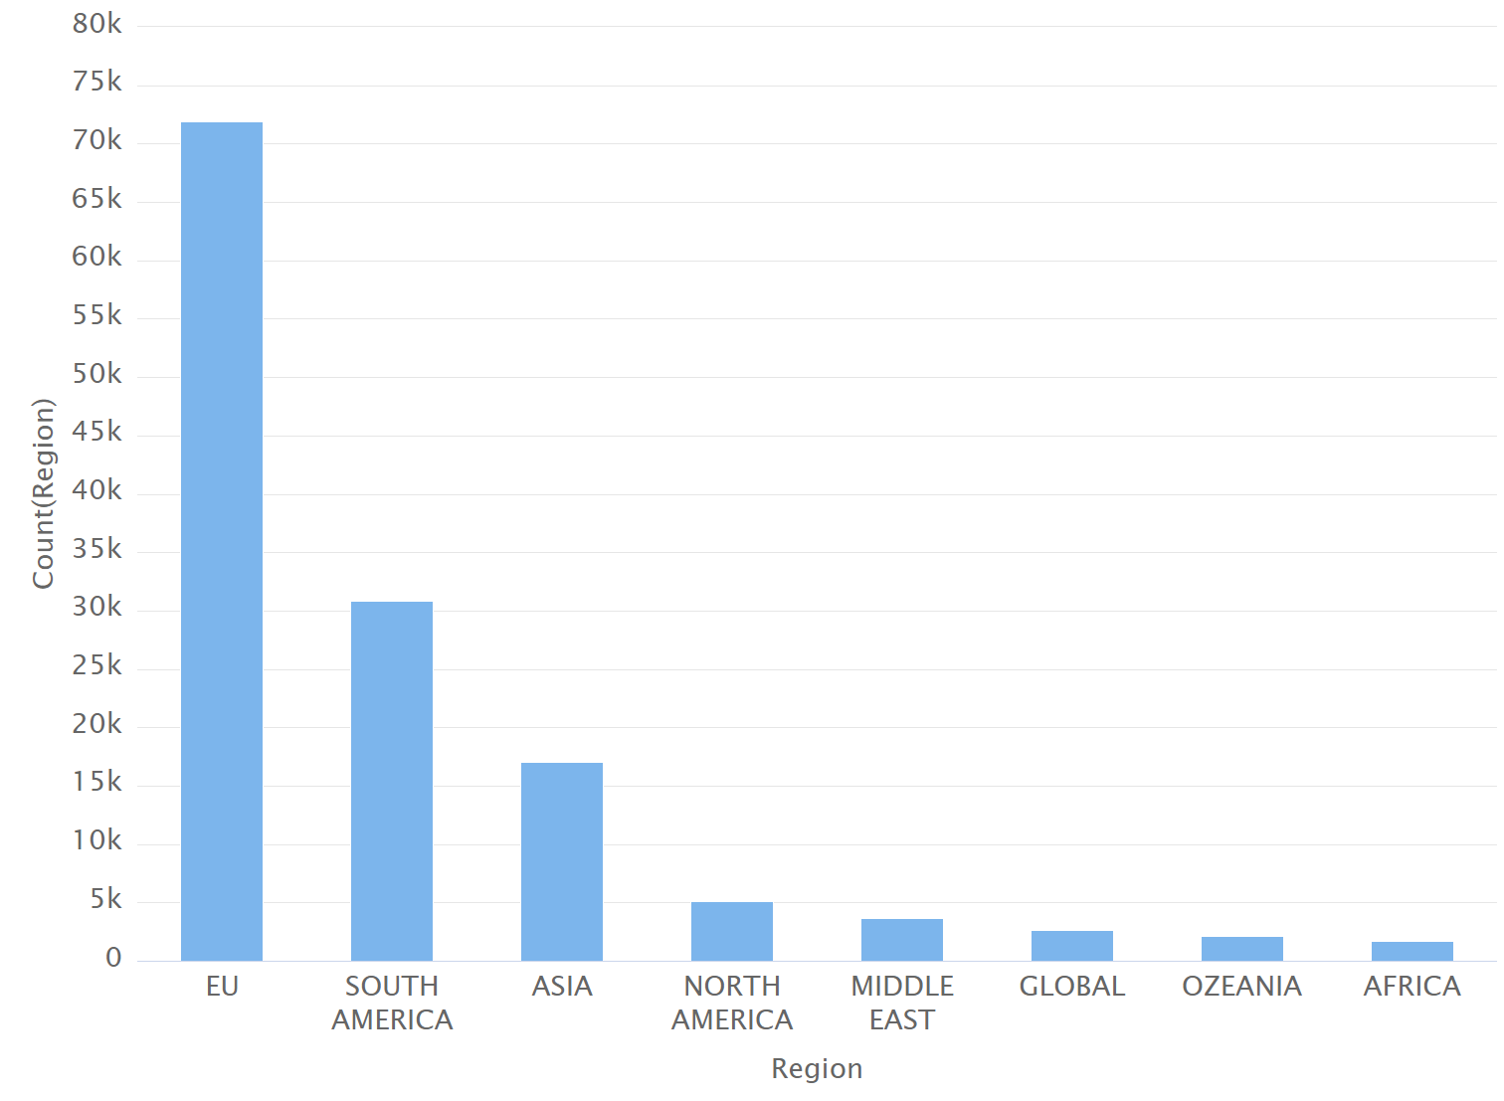
Modeling: REGION – DATA set

Slide 48
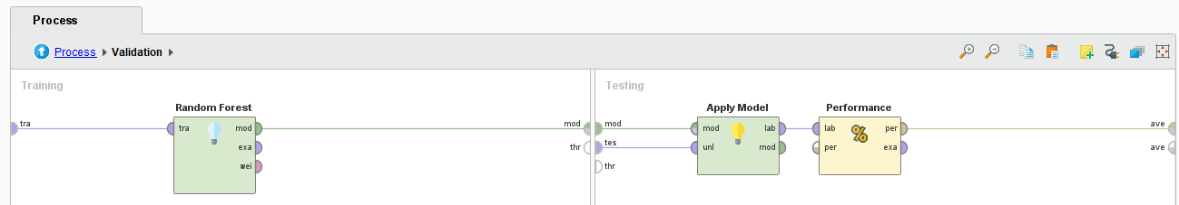
Modeling: REGION – Validation
Operator: Random Forest as its results were most pomising in previous models
Reliability highly depends on available datasets per region
Room for further Investigations

Slide 49
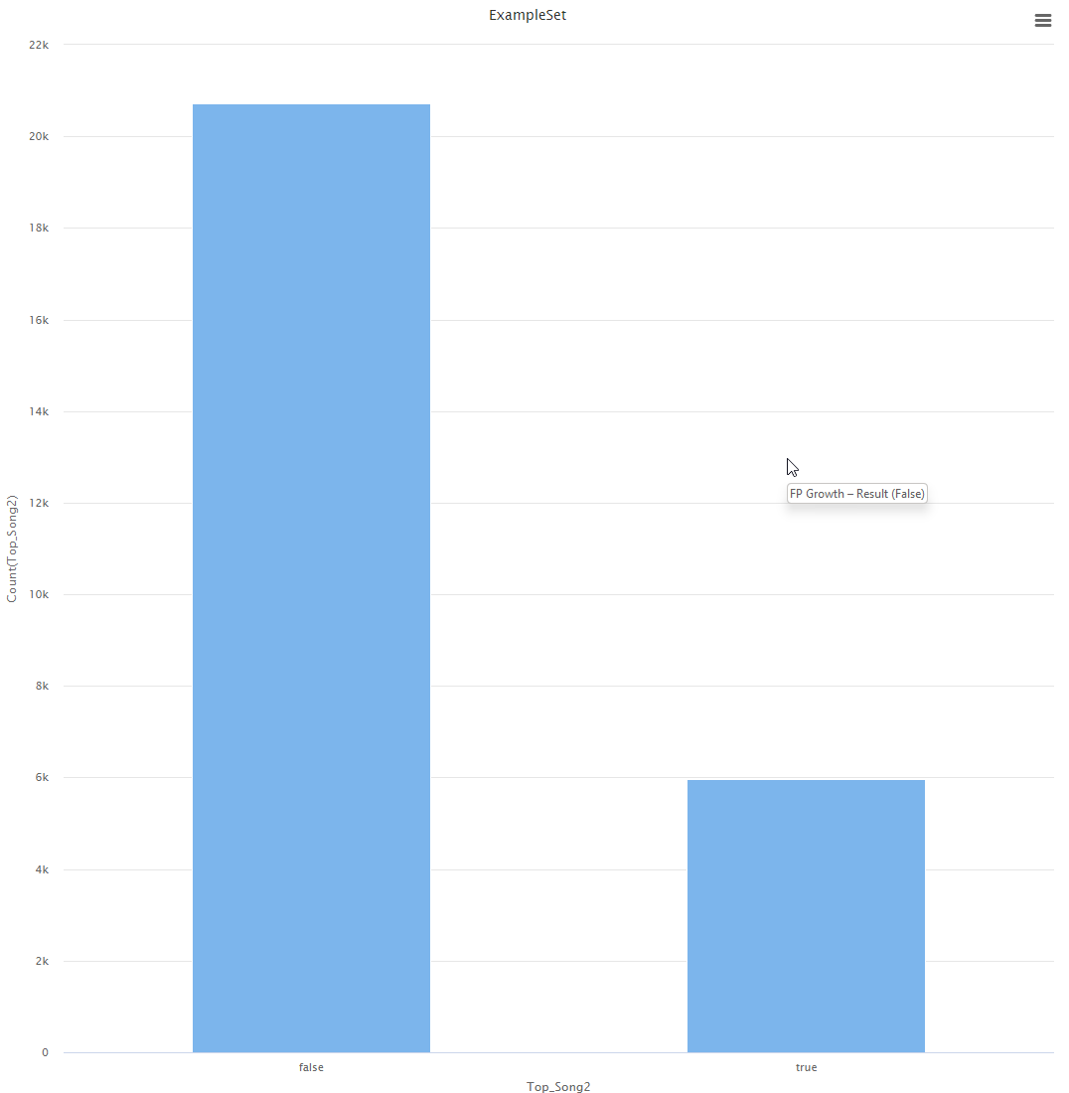
FIRST Iteration Unbalanced

Slide 50
First Iteration unbalanced

Slide 51
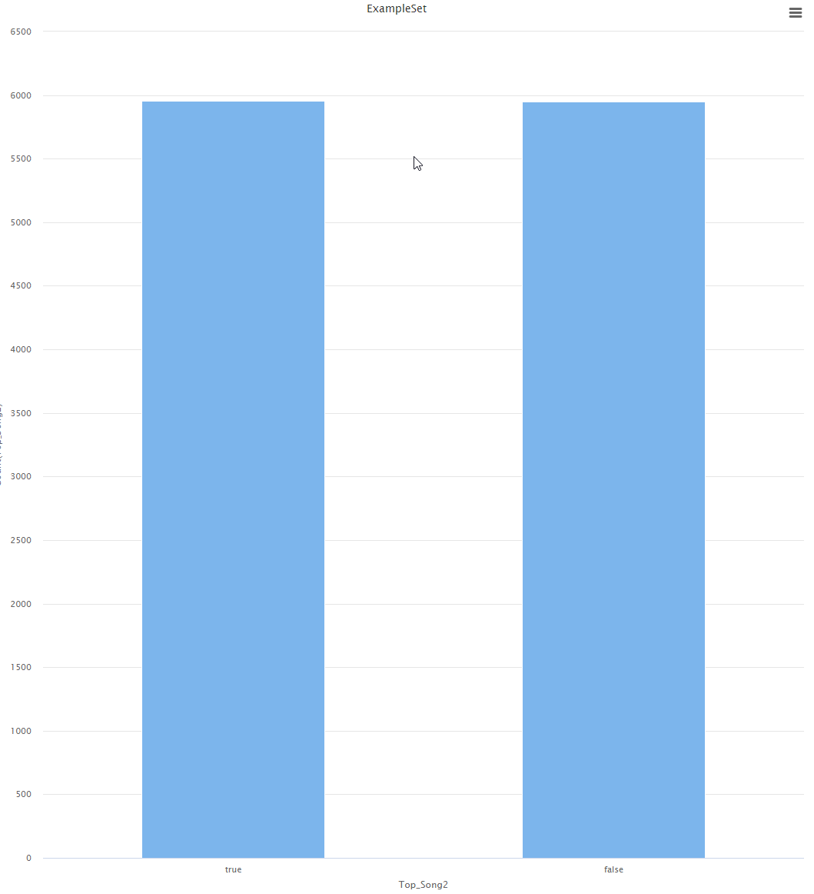
FIRST Iteration Balanced

Slide 52
First Iteration Balanced

Slide 53
The first iteration shows that we need to enrich our data
Two new data sets are needed to get following information:
artists.csv → Popularity of the artist
dict_artists.json → Recommendation of artists
JSON Data could not processed via RapidMiner, so we need to transform it Phyton to generate a local data whitch can be used with RapidMiner.

Slide 54
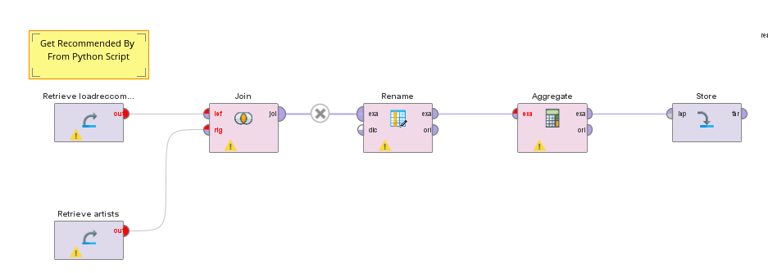
The first iteration shows that we need to enrich our data

Slide 55

The first iteration shows that we need to enrich our data
Wird angepasst

Slide 56

Second Iteration Model Template -- Parameter Tuning

Slide 57

Second Iteration Results After Training

Slide 58

Second Iteration Model Template -- Ensembles

Slide 59

Second Iteration Modeling Result – ROC unbalanced

Slide 60

Second Iteration Modeling Result – ROC Balanced

Slide 61
Second Iteration Balanced Model Results

Slide 64
Modeling: REGION – Result

Slide 65
Random forest is the best performing model

Slide 66
Reflection
Genre: We did not differentiate between different genres, an improvement could be to research top songs in different genres separately (e.g pop, rock, rap,…)
Our datasets where not sufficient for those kind of research there where too special and too much genres (e.g Greek pop, Japanese R&B,..). But those Genres could be classified in similar groups, means of course a lot of effort and time.
Time: We could also made a time series analysis. In our model we do not take into account if there where also trends during the different years or decades. Also seasonal differences could be interesting (e.g. Christmas songs)*
We find out that the popularity factor increases a lot if the artist are recommended by popular artist, but we still don´t know how the factor of recommendations are built. We could investigate in that fact more. What are the factors that a song is listed as a recommended song? What is needed, that a artist will be recommended?
Notes:
Introduction to use case, goal, selection of data set

Slide 67

Reflection
We could also investigate more into clustering in different countries.
We started to do that and clustered charts in Regions and saw differences between different countries in accuracy for example but overall the results were not really good. We would need more data to have a reliable model.
Notes:
Introduction to use case, goal, selection of data set

Slide 68

Reflection possible improvements in current Model setting
Sampling: We have join 2 data sets for sampling. Therefore we have 26.000 songs and only 6000 of them were top songs.
we will see in the next slide, that this is not sufficient for a real world data set
General pain point: It took really long to run our models (up to 1 day), so to see the result of an adjustment, take really long
We are unsure, if we are overfitting with our model ( see real world example in the next slide)
Notes:
Introduction to use case, goal, selection of data set

Slide 69

Reflection Apply MODEL on real World data
Notes:
Introduction to use case, goal, selection of data set

Slide 70
Reflection Apply MODEL on real World data
We identify nearly all top songs
But we also identify a lot of songs which are not top songs
Notes:
Introduction to use case, goal, selection of data set

Slide 71
conclusion
It's important to note that predicting music popularity/top song is not an exact science, and there are many factors that can influence the success of a song, such as marketing, promotion, and timing. Nonetheless, by using data and machine learning algorithms, it's possible to identify songs that have a higher probability of becoming popular/top song, and to make informed decisions based on that prediction.
However, looking to our real world data, our model seems to be not that bad, now we have to investigate more to ensure, that there is no overfitting.
Notes:
Introduction to use case, goal, selection of data set

